Slide 1
Introduction to Data Visualization and Best Practices
Richard Johansen
August 5th 2019
richard.Johansen@uc.edu

Slide 2
Workshop Agenda
Introduction to Data Visualization
Why We Visualize
Understanding Data
Visualizations
Tools and Software
Visualization Design and Best Practices

Slide 3
Workshop Agenda
Introduction to Data Visualization
Why We Visualize
Understanding Data
Visualizations
Tools and Software
Visualization Design and Best Practices

Slide 4
What is Data Visualization
“Visualization transforms data into images that effectively and accurately represent information about the data.”
–Schroeder et al. The Visualization Toolkit, 2nd ed. 1998
“Data graphics visually display measured quantities by means of the combined use of points, lines, a coordinate system, numbers, symbols, words, shading, and color.”
–Edward Tufte The Visual Display of Quantitative Information (2nd Ed.)

Slide 5
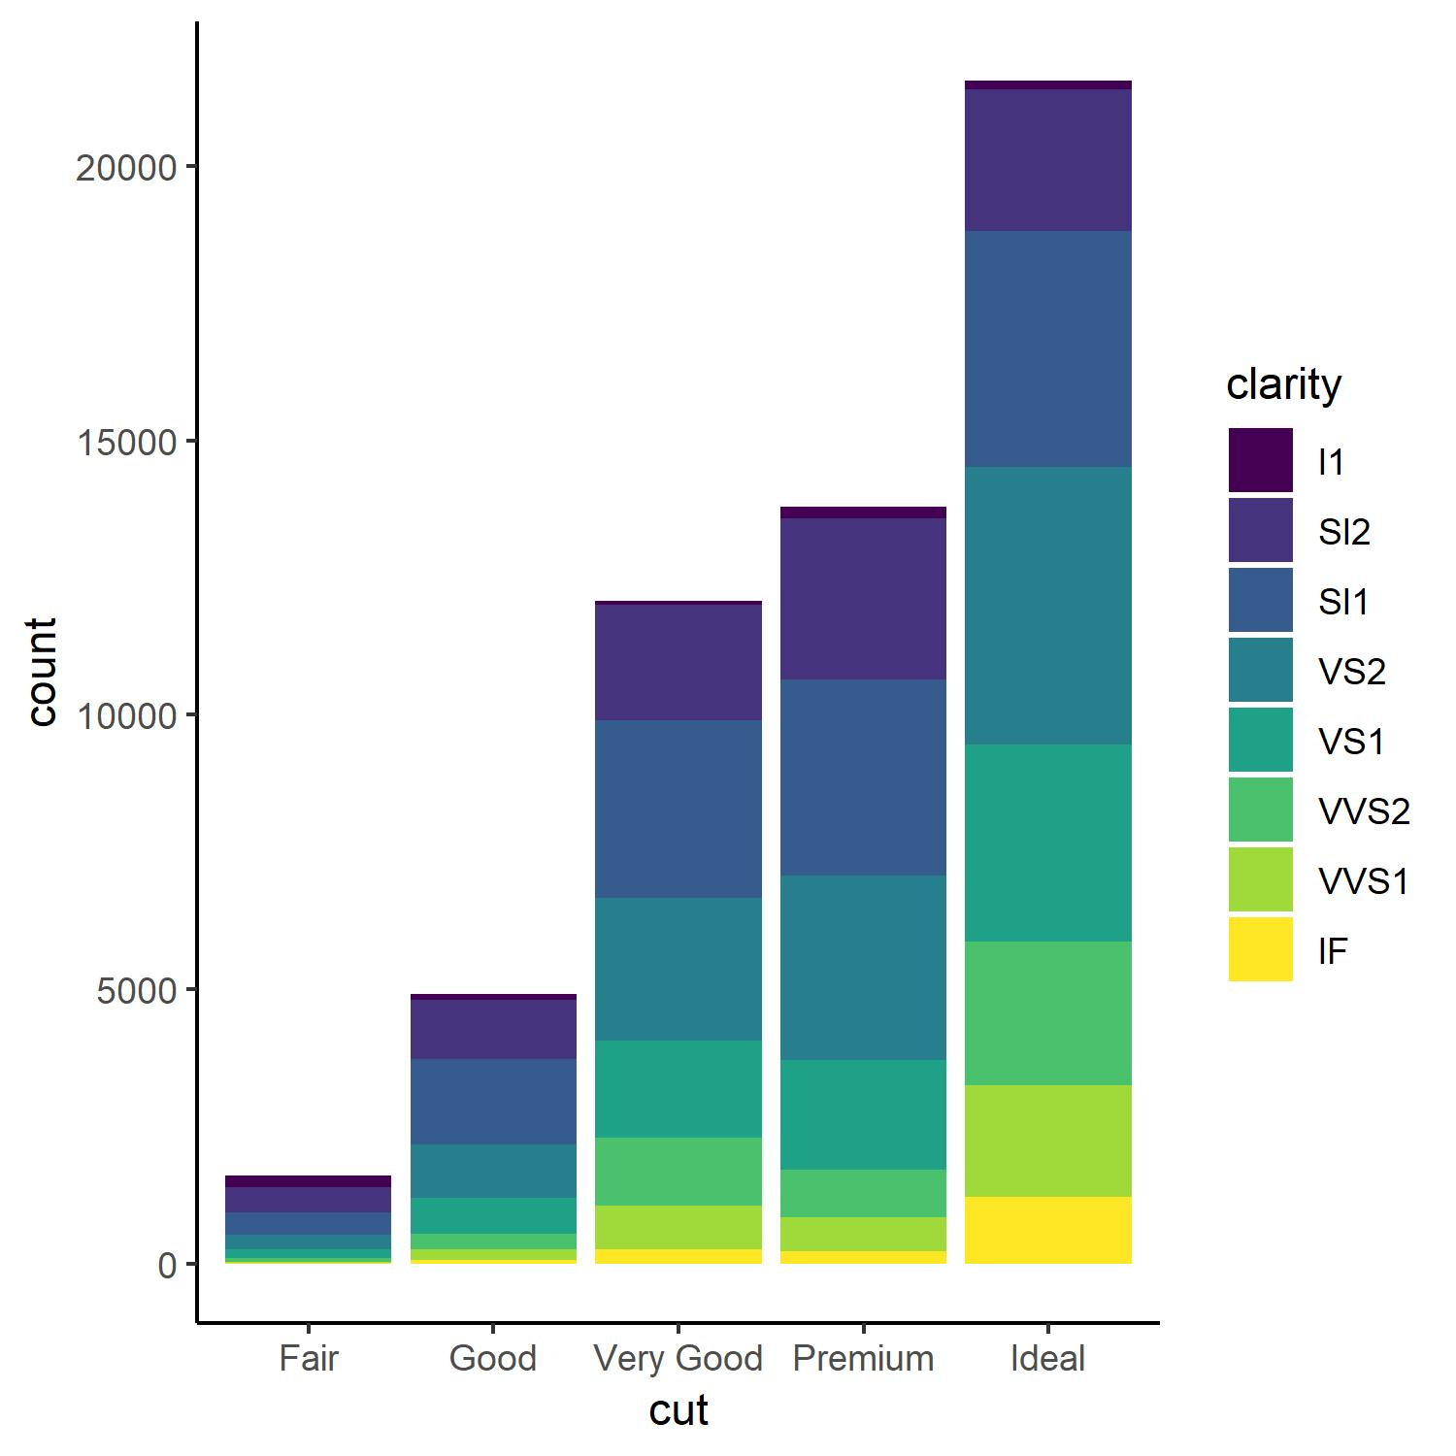
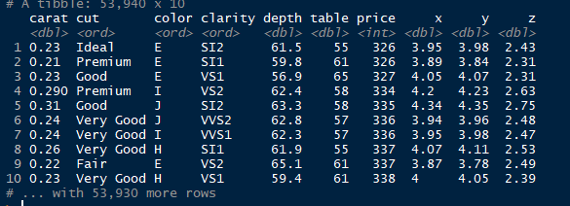
Why is Data Visualization Important?
A picture is worth a 1,000 words (observations)
–Tess Flanders 1911

Slide 6
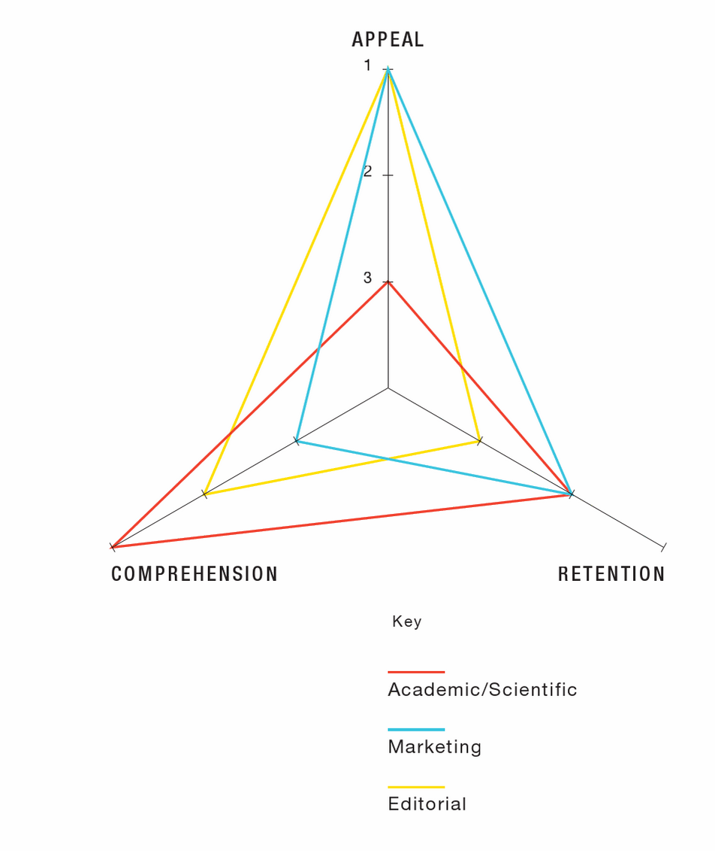
Before You Start
Who is the audience?
What is the purpose or goal?
What is the story?
What are the standards or conventions?
Infographics : The Power of Visual Storytelling by Lankow, Jason, Crooks, Ross, Ritchie, Josh
Notes:
Hannah - before and throughout the process, it is important to consider the audience, purpose/story, and any domain standards or conventions.

Slide 7
Workshop Agenda
Introduction to Data Visualization
Why We Visualize
Understanding Data
Visualizations
Tools and Software
Visualization Design and Best Practices

Slide 8
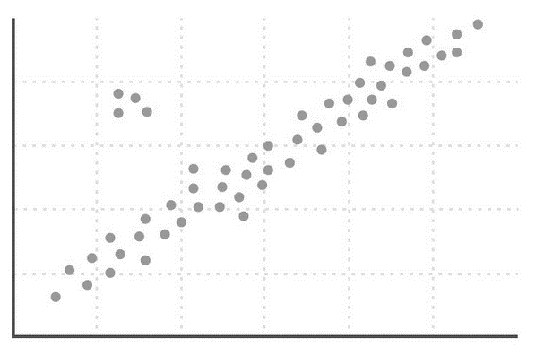
Why Do Visualization
Reasons for doing data visualization
Exploration
Use visualizations as a means of data exploration
Analysis
Verify (or Falsify) a hypothesis
Presentation
Visualization is used to communicate results or findings

Slide 9
Why Do Visualization
Reasons for doing data visualization
Exploration
Use visualizations as a means of data exploration
Analysis
Verify (or Falsify) a hypothesis
Presentation
Visualization is used to communicate results or findings

Slide 10

Why Do Visualization
Reasons for doing data visualization
Exploration
Use visualizations as a means of data exploration
Analysis
Verify (or Falsify) a hypothesis
Presentation
Visualization is used to communicate results or findings

Slide 11
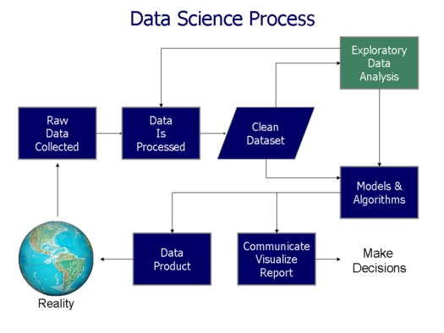
Data Science Process
Acquire Data
“Know your data”
Clean and Pre-Process
Visualize (explore)
Model/Analyze
Communicate Findings/ Data Production
https://commons.wikimedia.org/wiki/File:Data_visualization_process_v1.png
Notes:
Jennifer

Slide 12
Workshop Agenda
Introduction to Data Visualization
Why We Visualize
Understanding Data
Visualizations
Tools and Software
Visualization Design and Best Practices

Slide 13
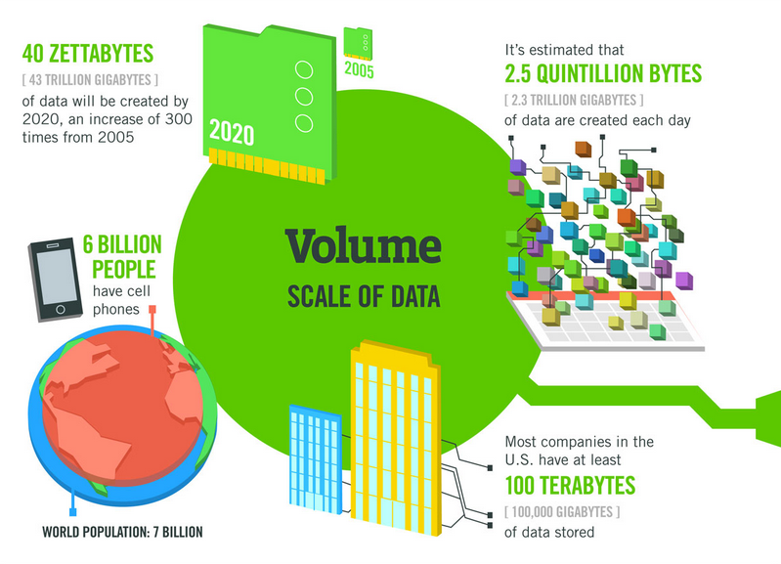

Data Doesn’t Sleep
A Minute on the Internet
16M texts
156M emails
900K FB logins
1.8M Snaps
450K Tweets
3.5M Google Searches
1M tinder Swipes
70K Hours of Netflix
$751,000 Spent Online
http://www.visualcapitalist.com/happens-internet-minute-2017/

Slide 14
Data Types
Not all data are created equal!
Qualitative
Nominal
Ordinal
Quantitative
Numerical
Discrete
Continuous

Slide 15
Nominal Data
Data that can be counted, but not aggregated or ordered
Examples:
States – Ohio, Kentucky, Indiana
Eye Color –Blue, Brown, Green, Hazel
Music Genre – Rock, Classical, Rap, Pop

Slide 16
Ordinal Data
Data that can be counted and ordered, but not aggregated.
Examples:
Quality – Poor, Average, Good, Excellent
Sizes – Small, Medium, Large
Letter Grades – A, B, C, D, F
Ranked Numbers – Position in a race (1st, 2nd, 3rd)

Slide 17
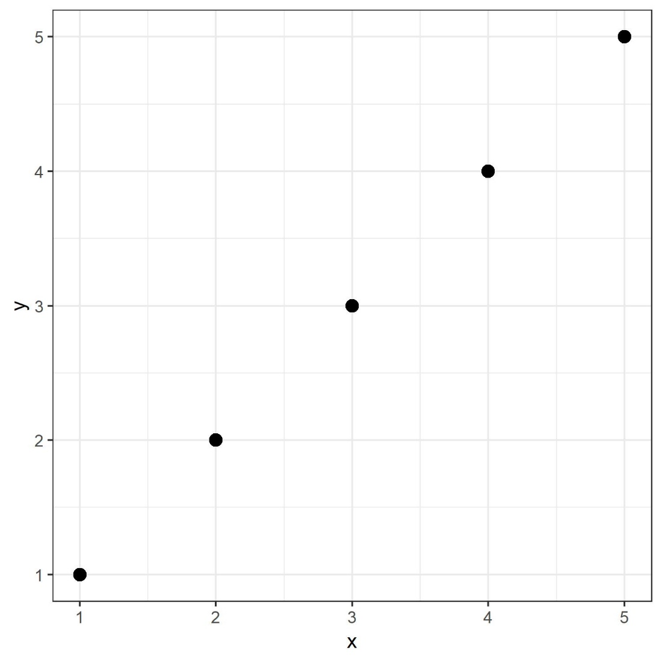
Numerical Data
Numerical data can be counted, ordered, and aggregated.
Two types of quantitative data
Discrete
Number of People
Sampling –Hourly average temperature
Continuous
Elevation
Temperature

Slide 18
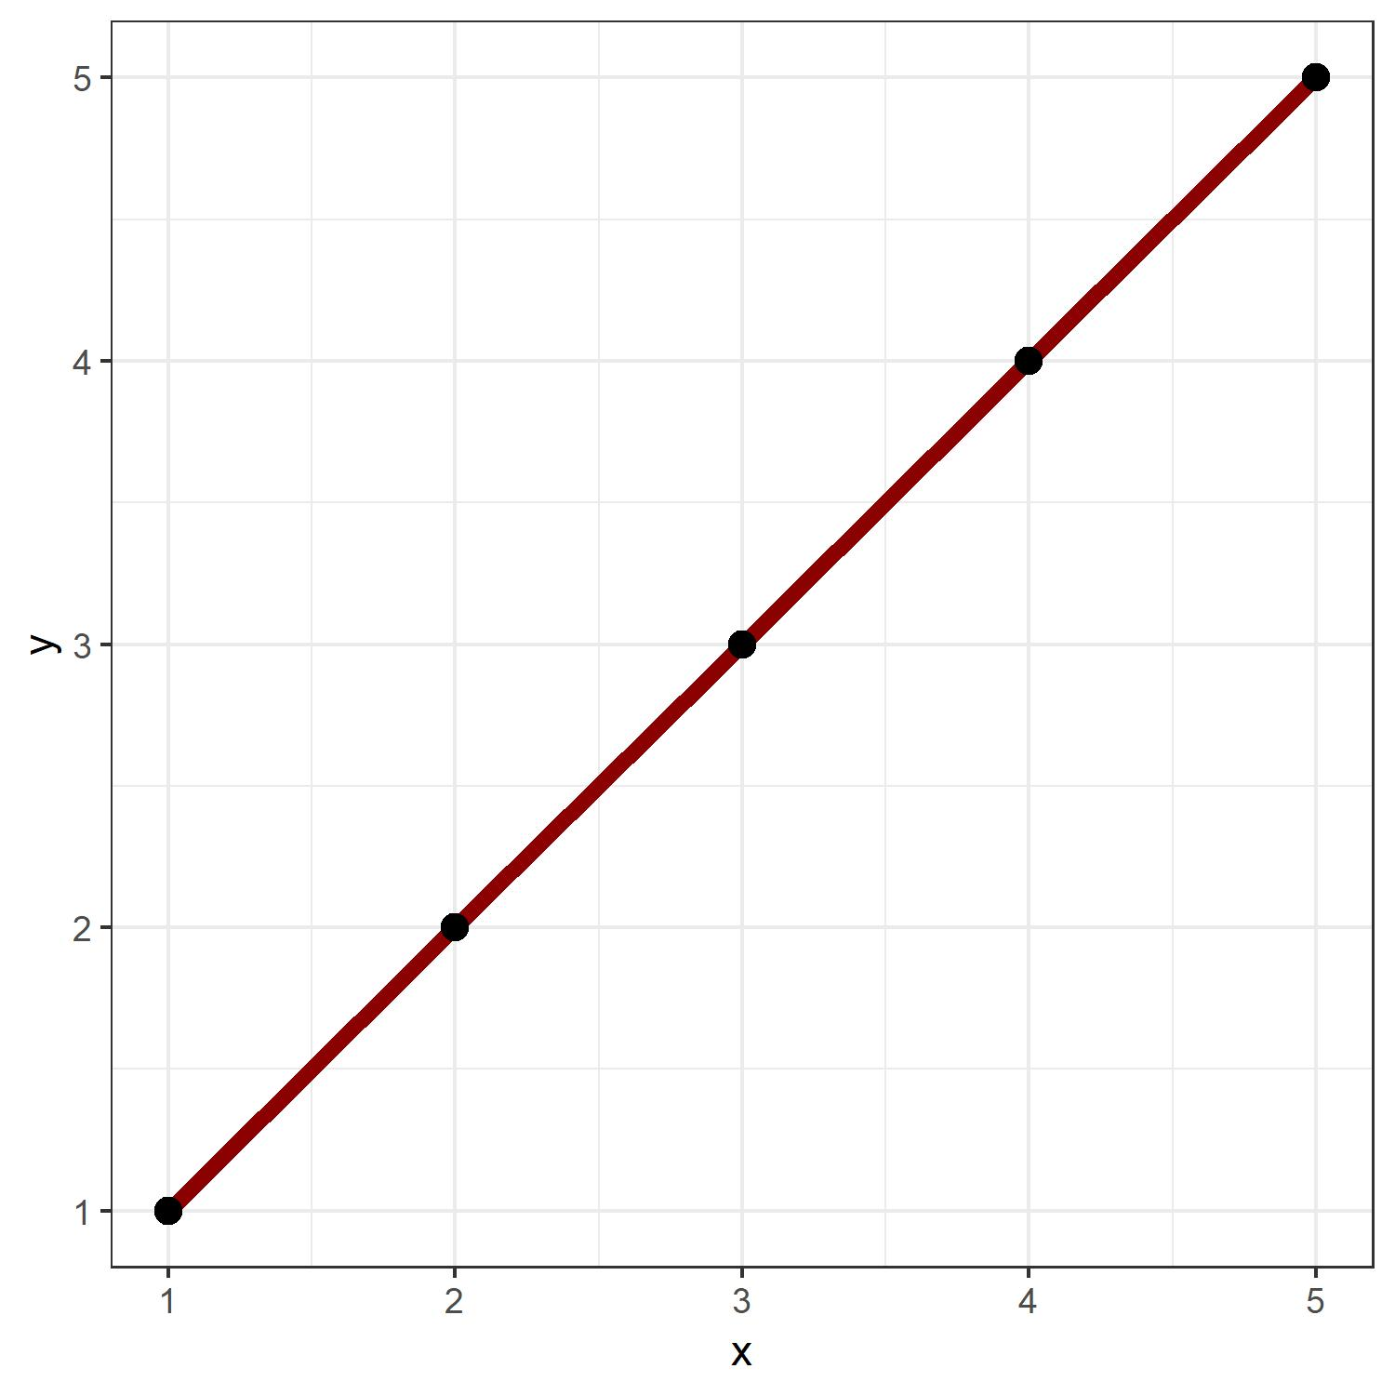
Numerical Data
Numerical data can be counted, ordered, and aggregated.
Two types of quantitative data
Discrete
Number of People
Sampling –Hourly average temperature
Continuous
Elevation
Temperature

Slide 19
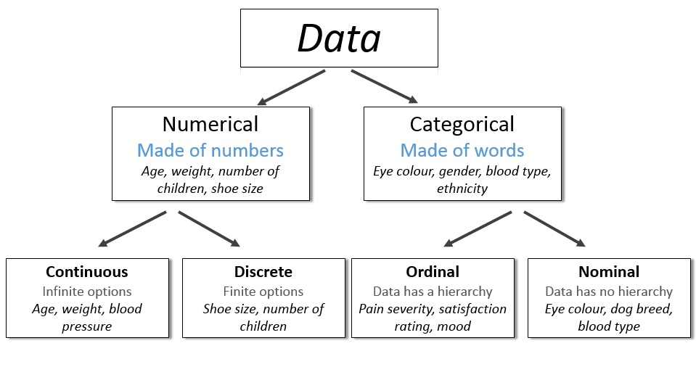
http://survivestatistics.com/variables/

Slide 20
Workshop Agenda
Introduction to Data Visualization
Why We Visualize
Understanding Data
Visualizations
Tools and Software
Visualization Design and Best Practices

Slide 21
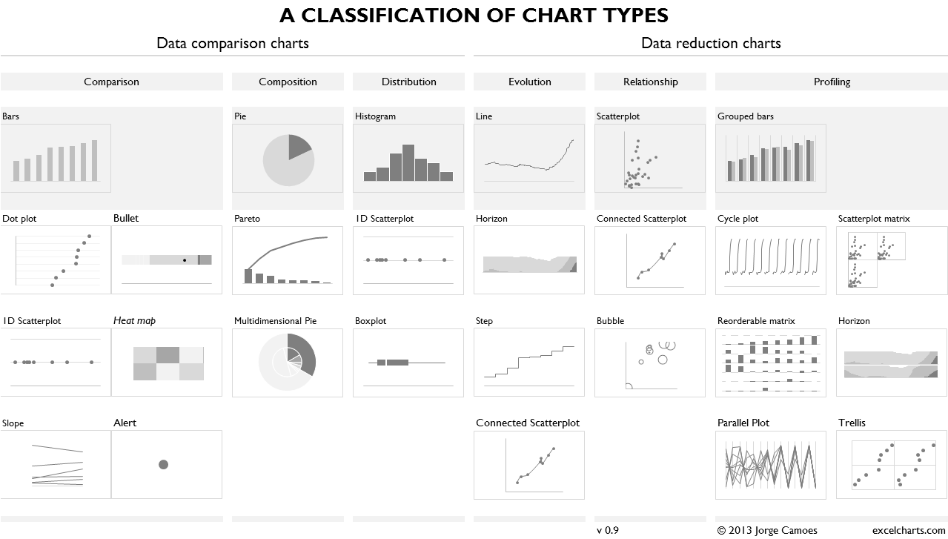
Four Basic Chart Types
Comparison
Composition
Distribution
Relationship
https://excelcharts.com/classification-chart-types/

Slide 22
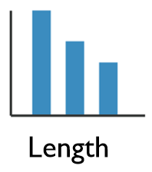
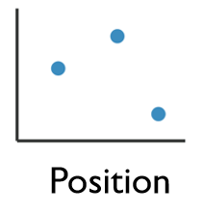
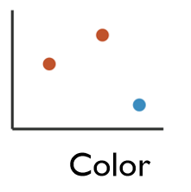
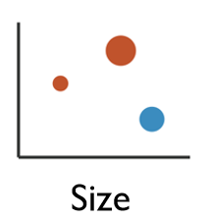
Enhancing Visualizations
1 Dimensional Data
Length
2 Dimensional Data
Position
2+ Dimensional Data
Position
Color Hue/Saturation
Size
Shape

Slide 23
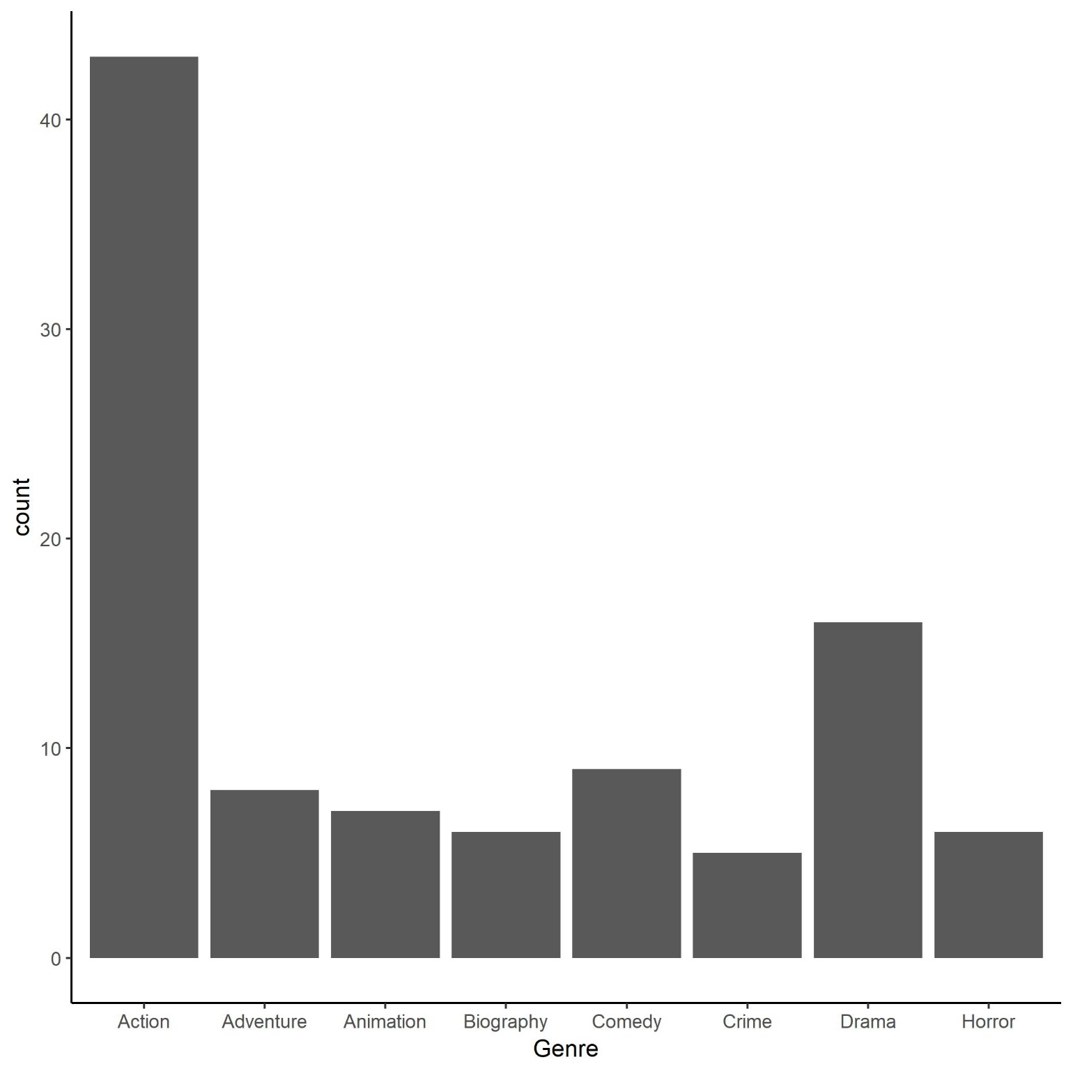
Column Charts
Comparison or Distribution of Groups
Column
Bar
Histogram

Slide 24
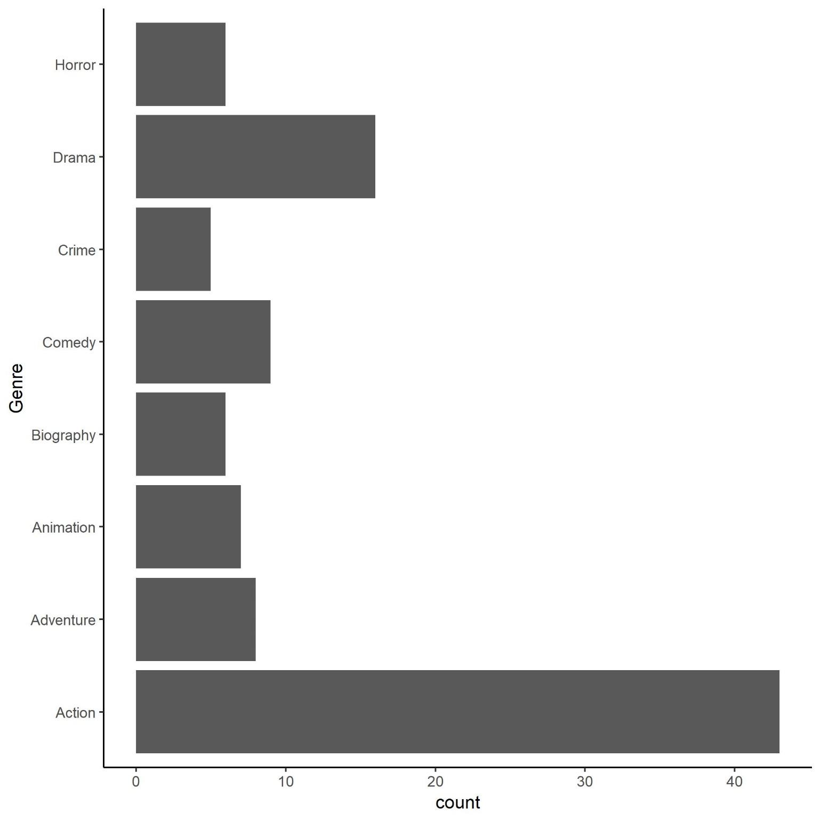
Column Charts
Comparison or Distribution of Groups
Column
Bar
Histogram

Slide 25
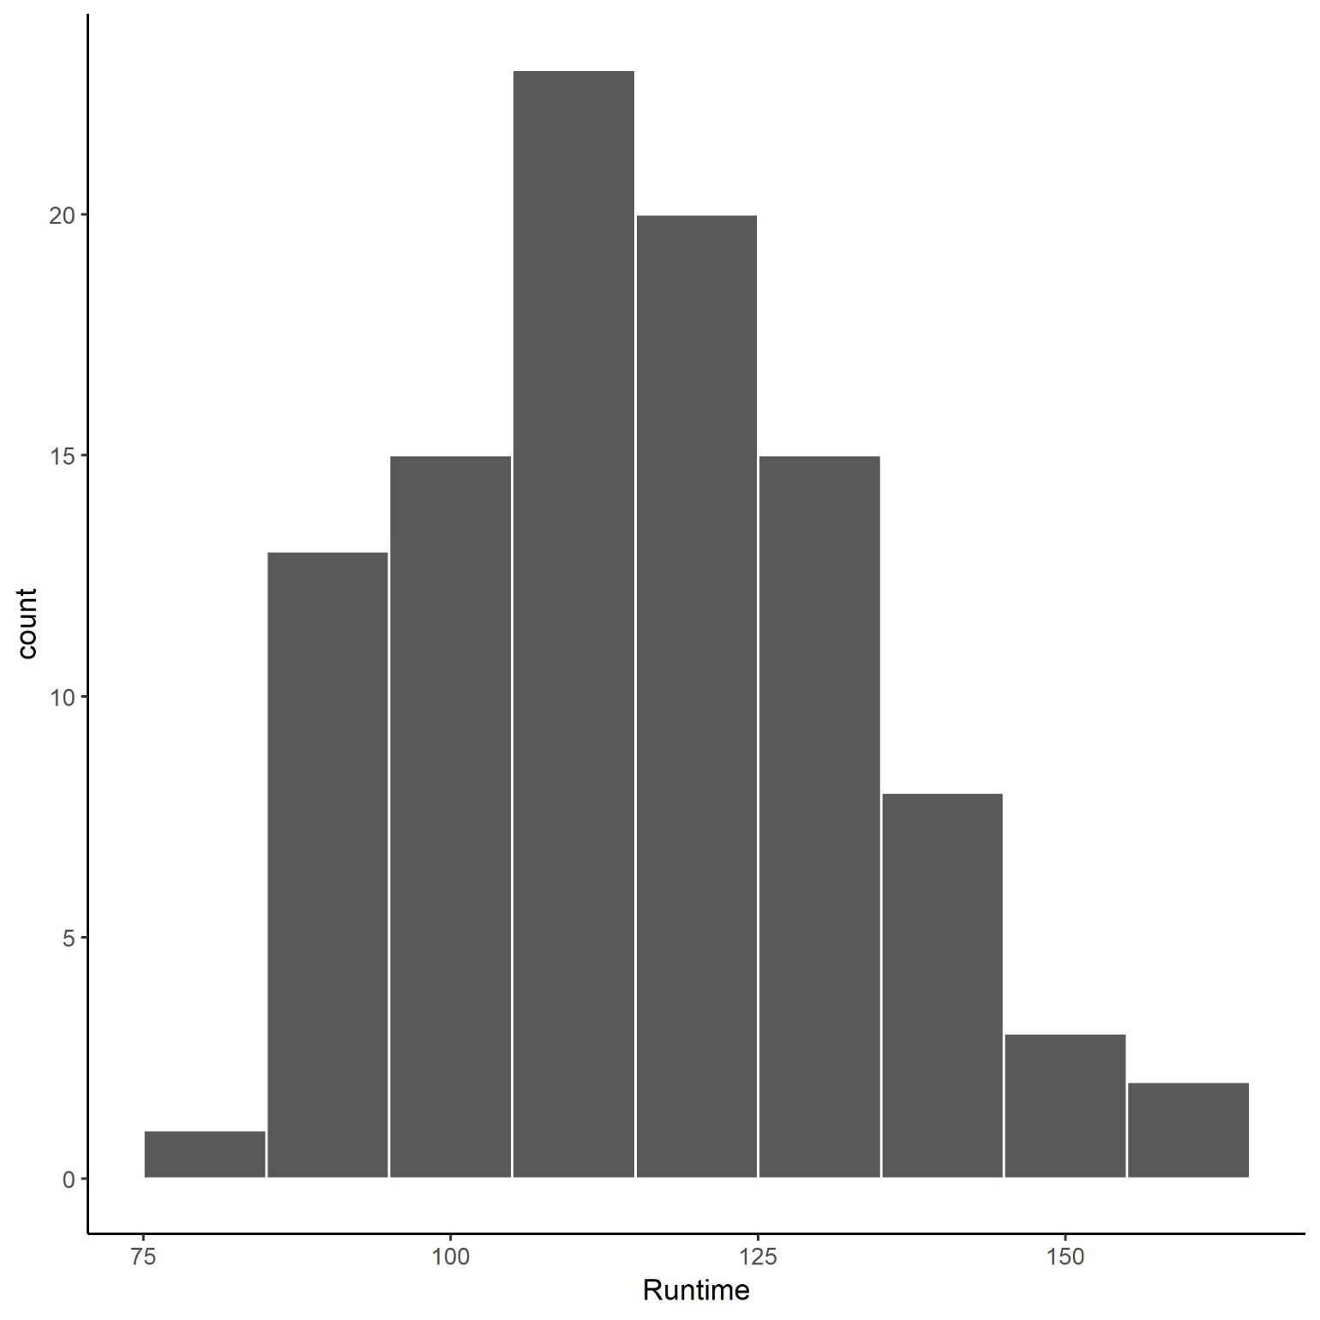
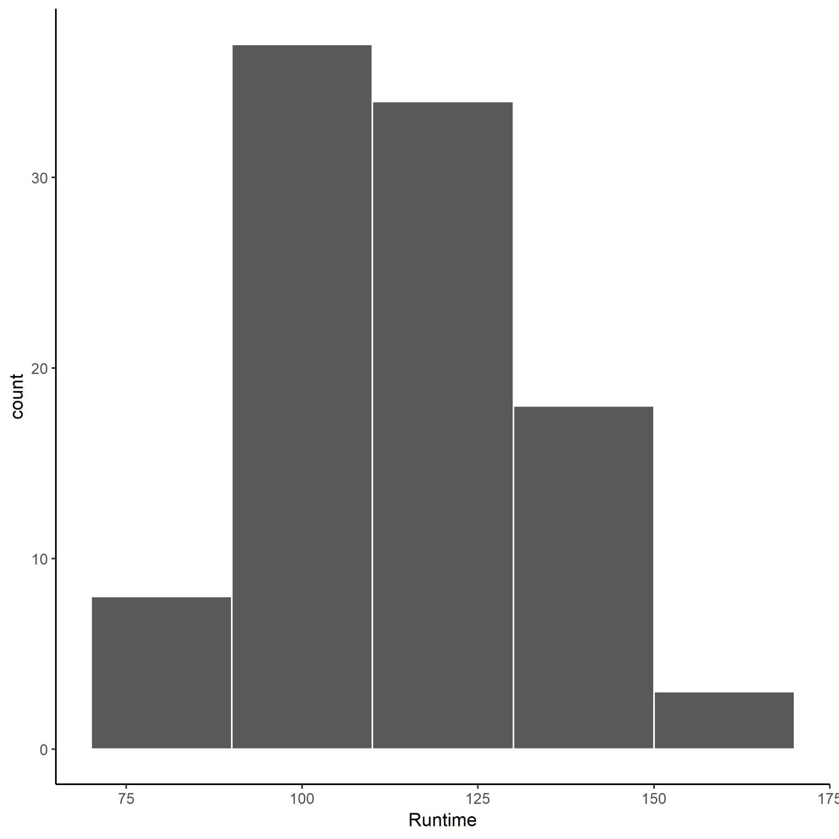
Column Charts
Comparison or Distribution of Groups
Column
Bar
Histogram

Slide 26
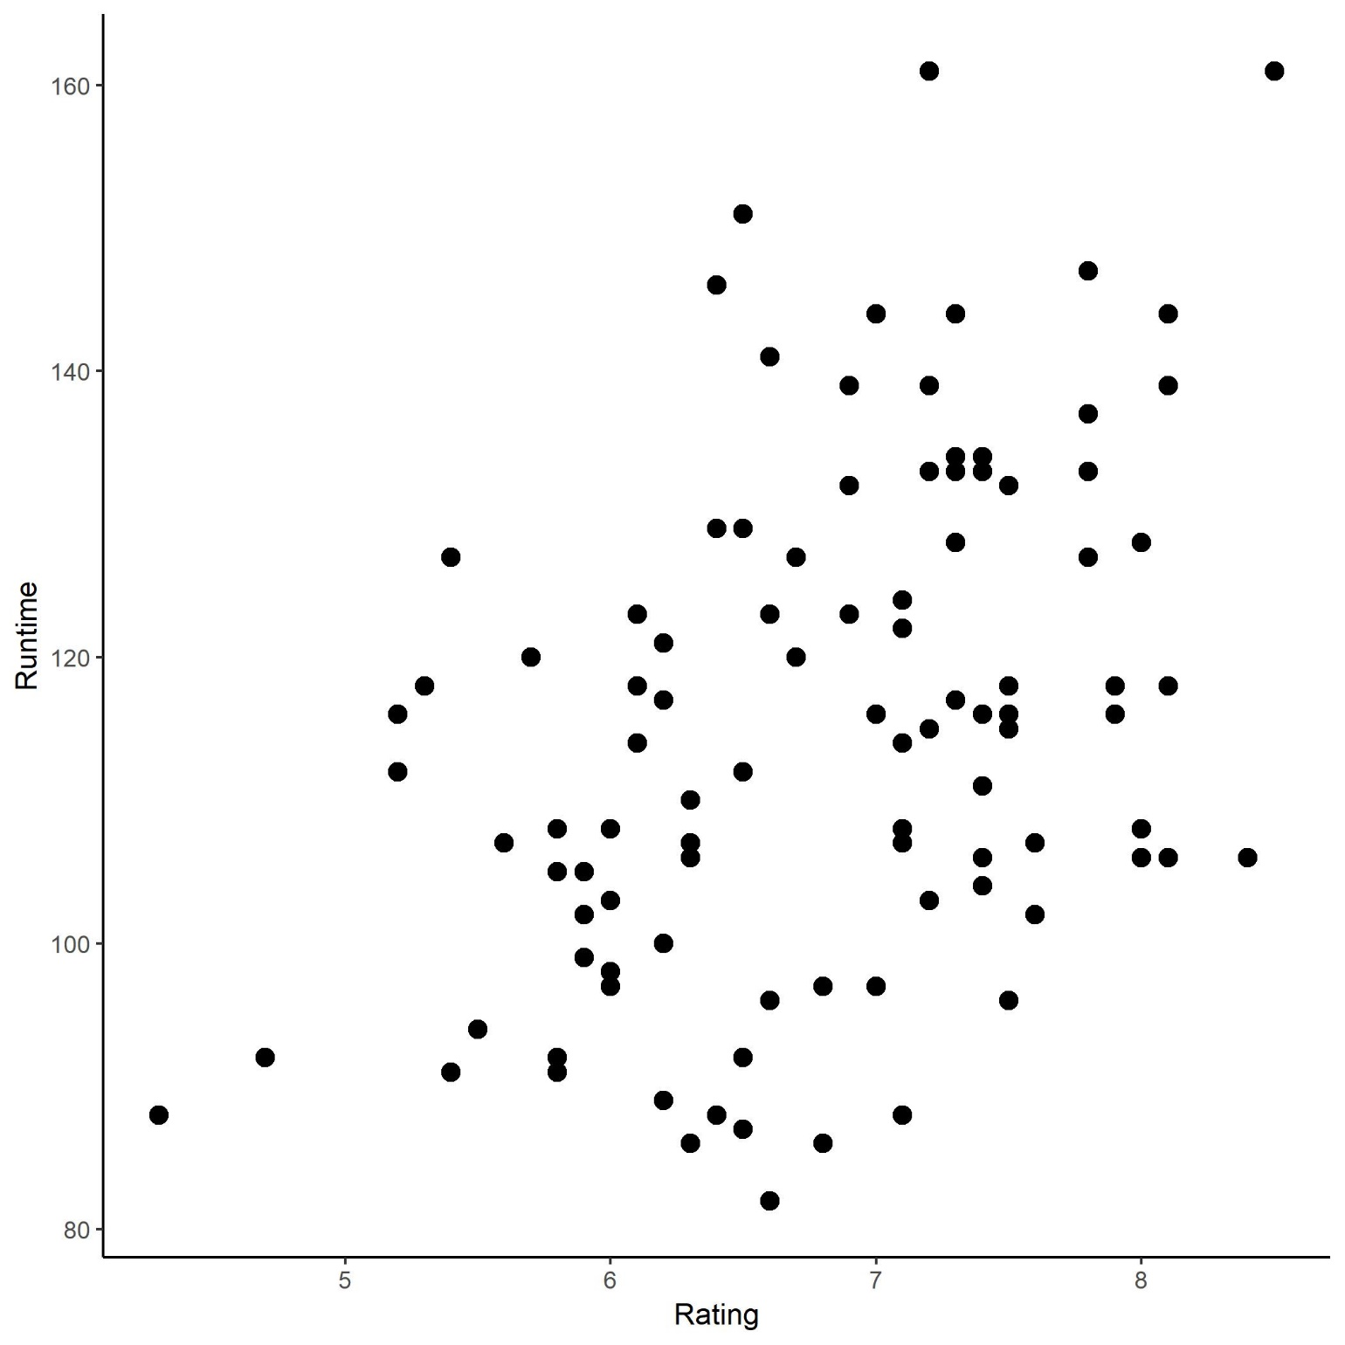
Scatter and Bubble Plots
Distribution and Relationships between two or more variables
Scatter Plot
Bubble Chart

Slide 27
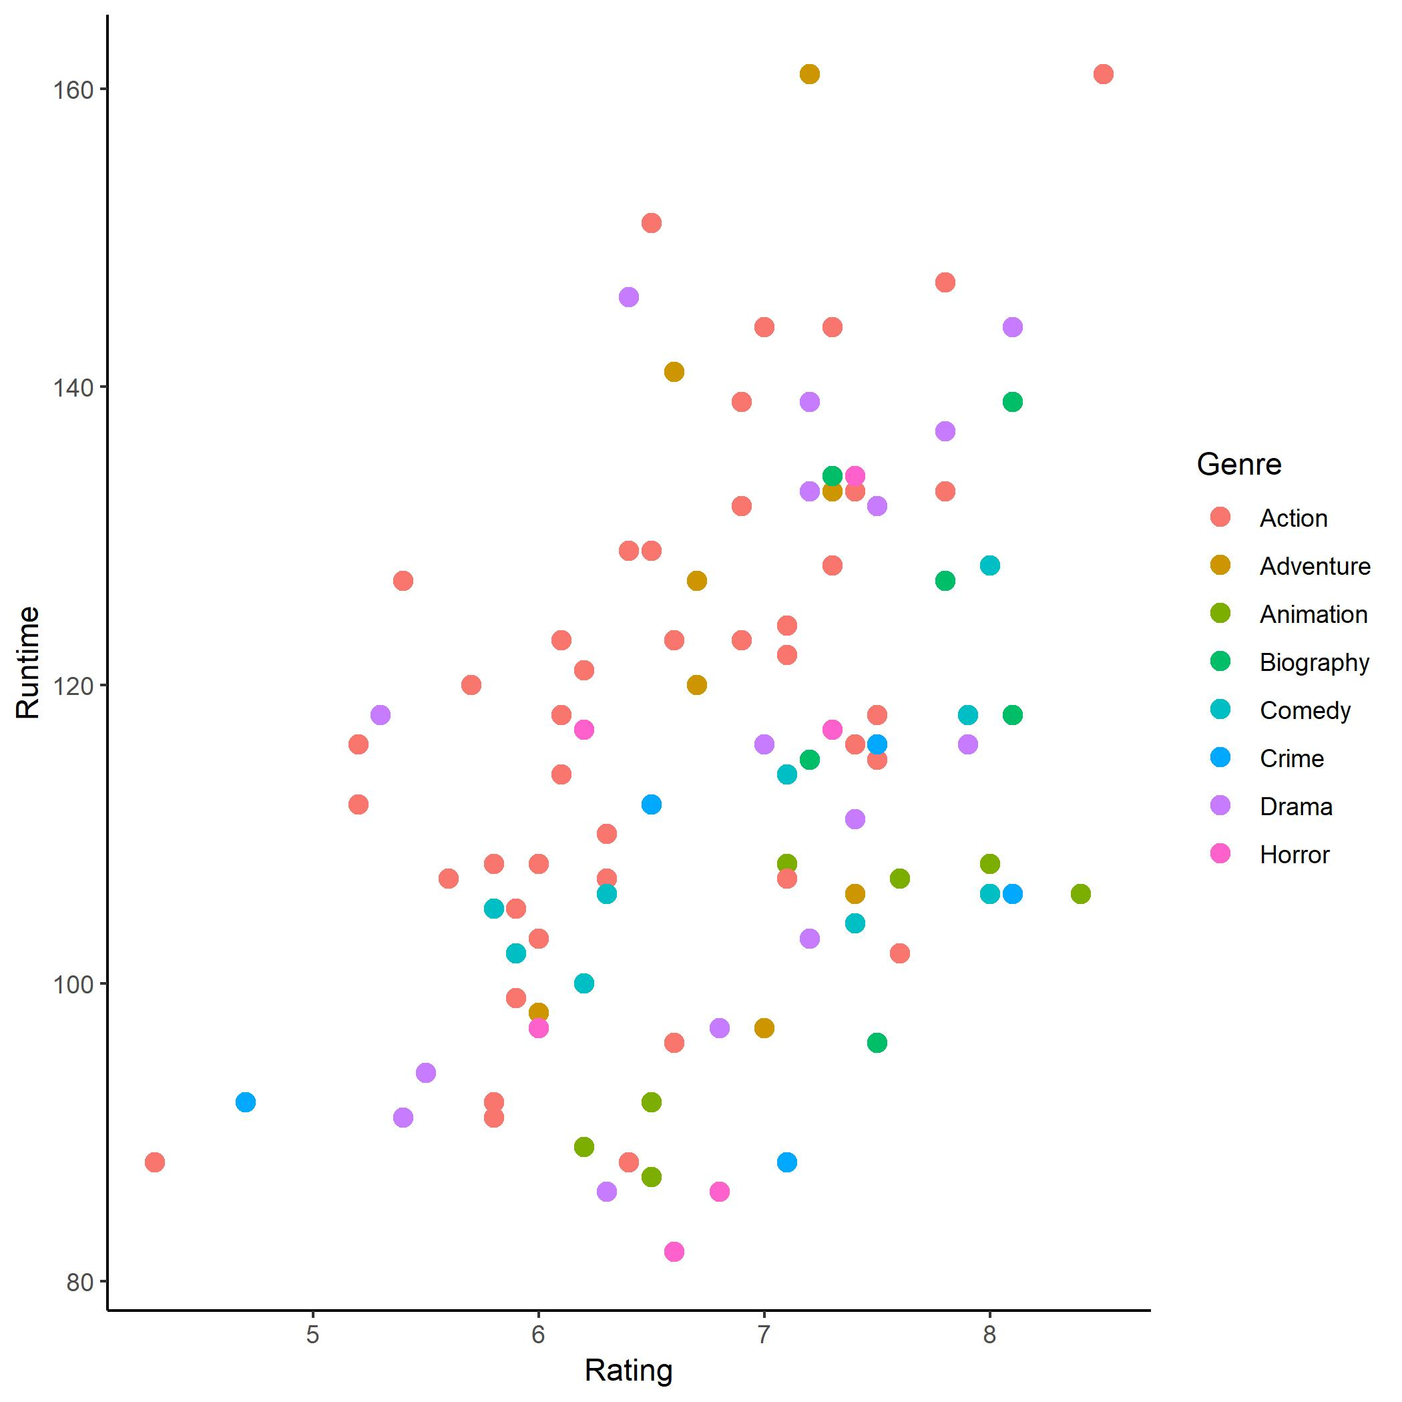
Scatter and Bubble Plots
Distribution and Relationships between two or more variables
Scatter Plot
Bubble Chart

Slide 28
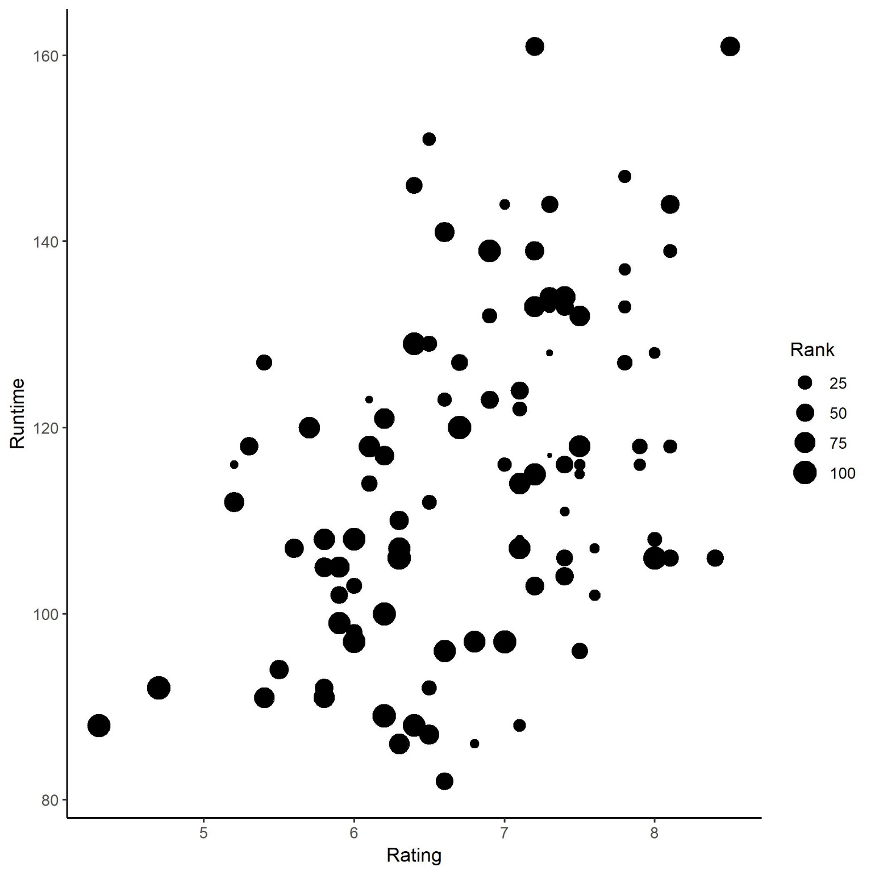
Scatter and Bubble Plots
Distribution and Relationships between two or more variables
Scatter Plot
Bubble Chart

Slide 29
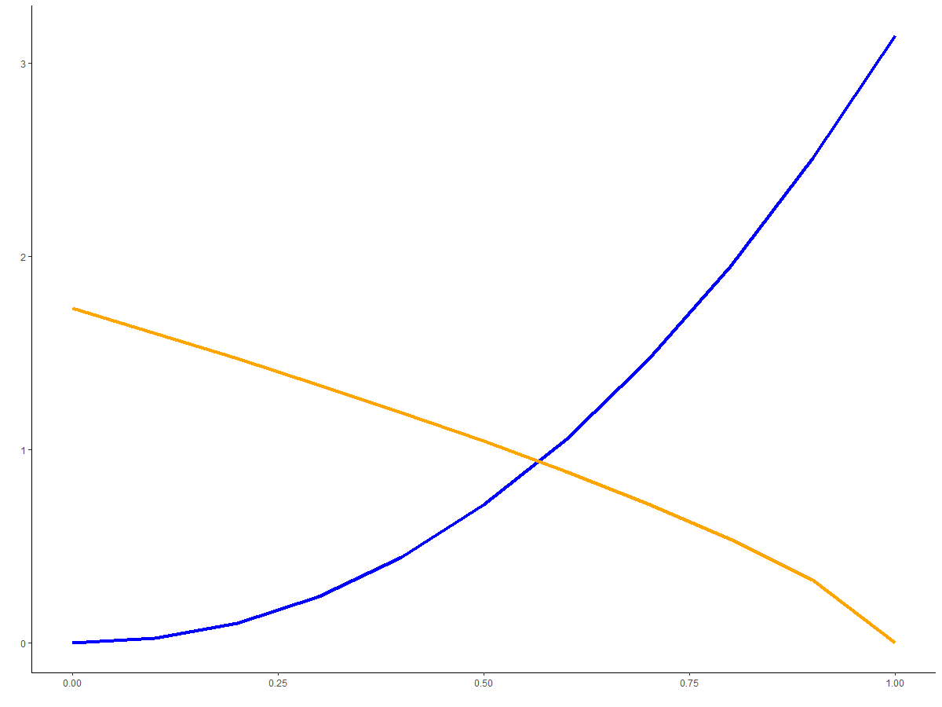
Line and Area Graphs
Distribution and Relationships over continuous data
Line
Area

Slide 30
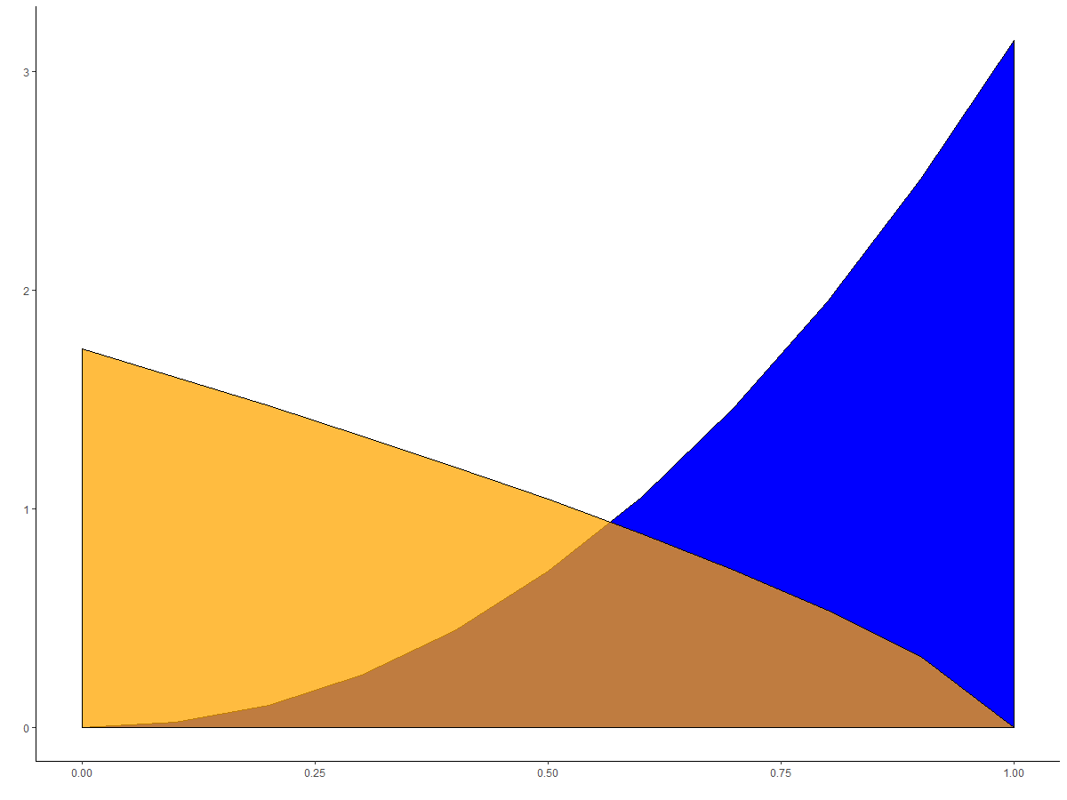
Line and Area Graphs
Distribution and Relationships over continuous data
Line
Area

Slide 31
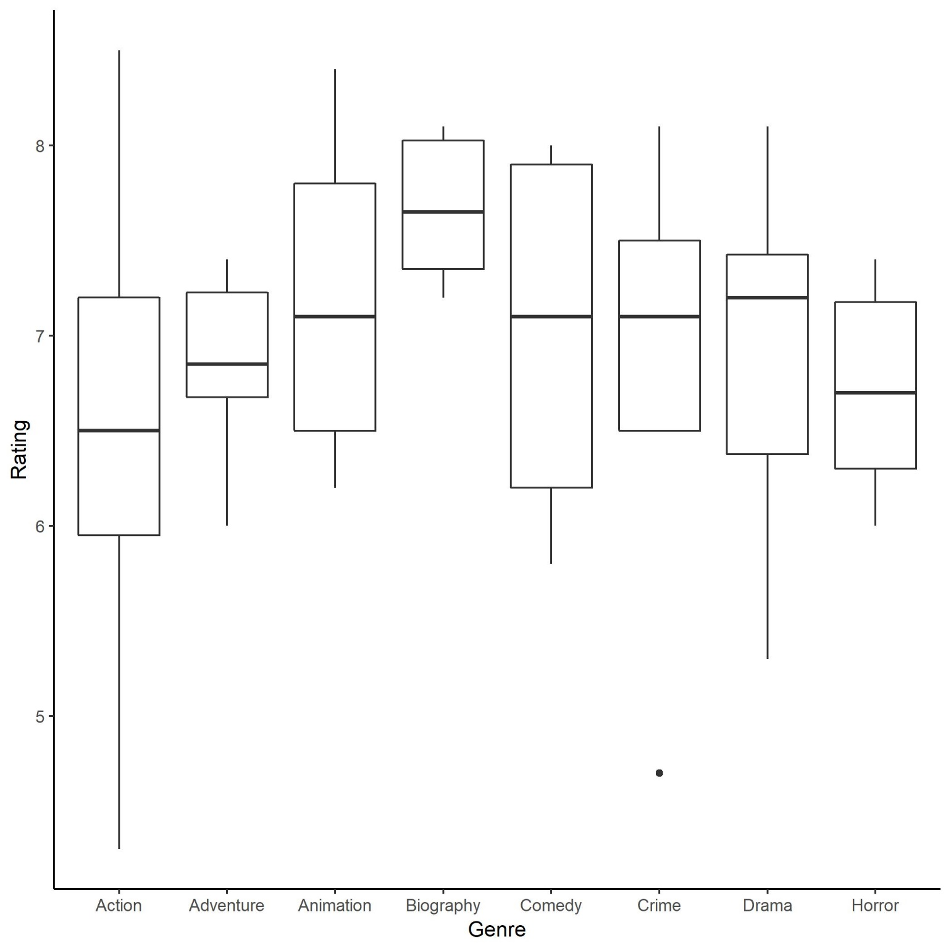
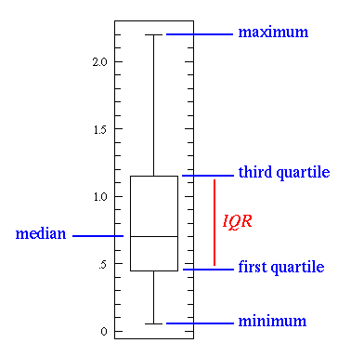
Statistical Graphs
Provide distribution and descriptive statistical information
Boxplots
Violin Graphs

Slide 32
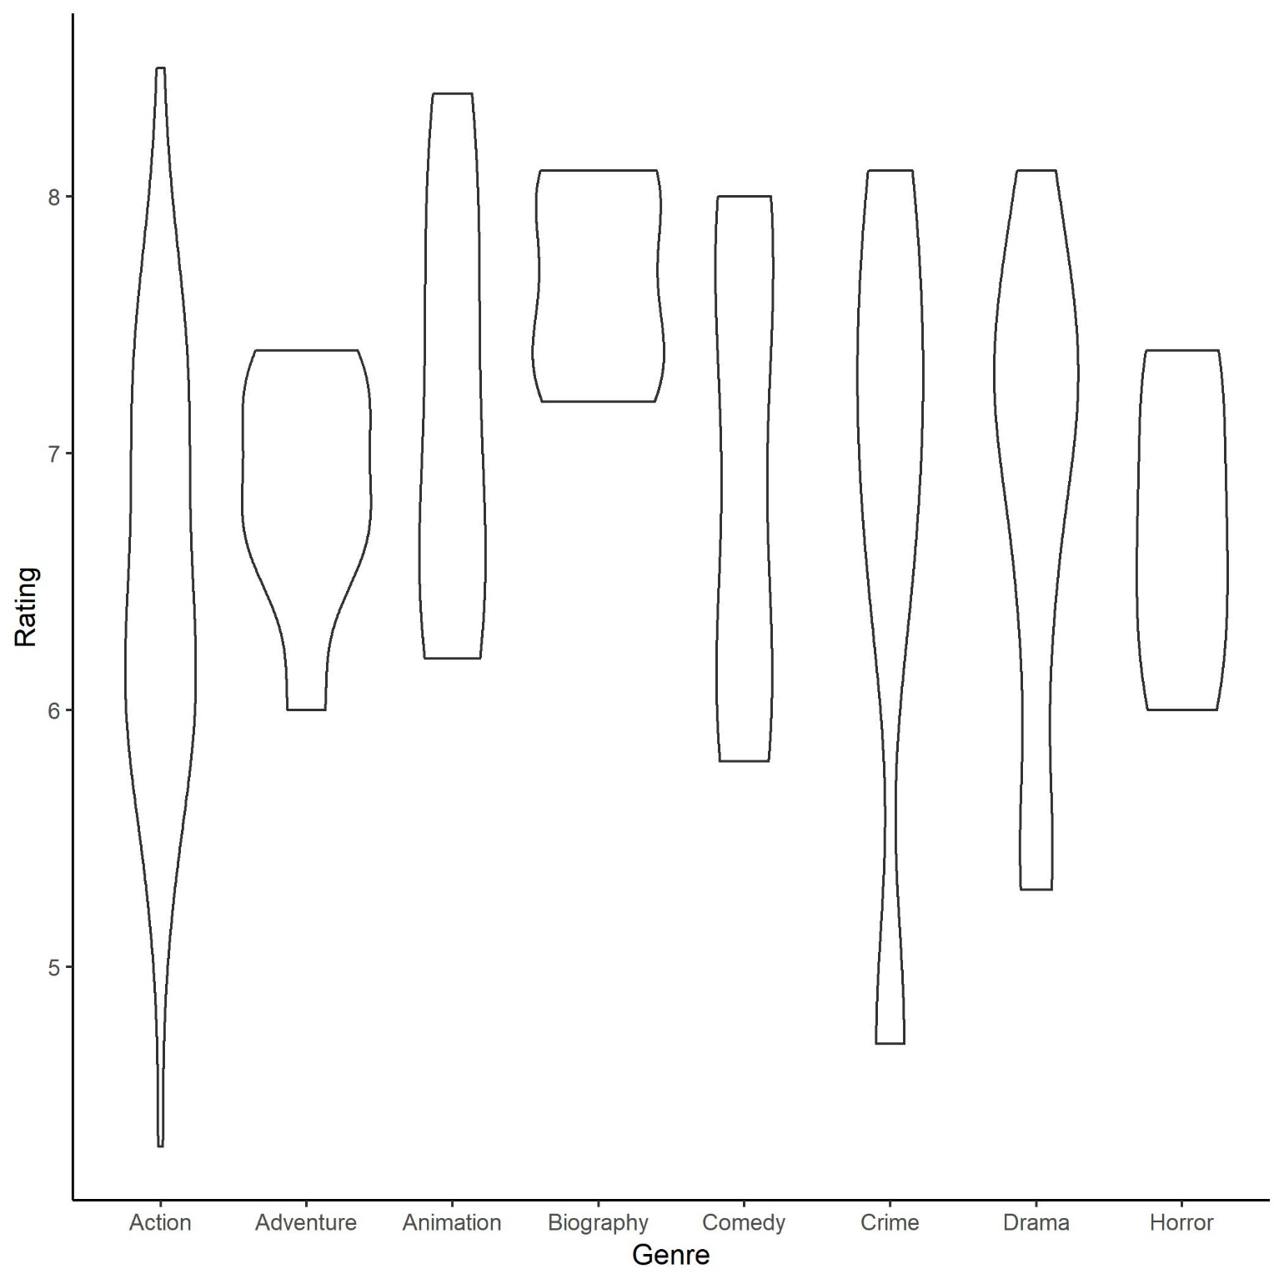
Statistical Graphs
Provide distribution and descriptive statistical information
Boxplots
Violin Graphs

Slide 33
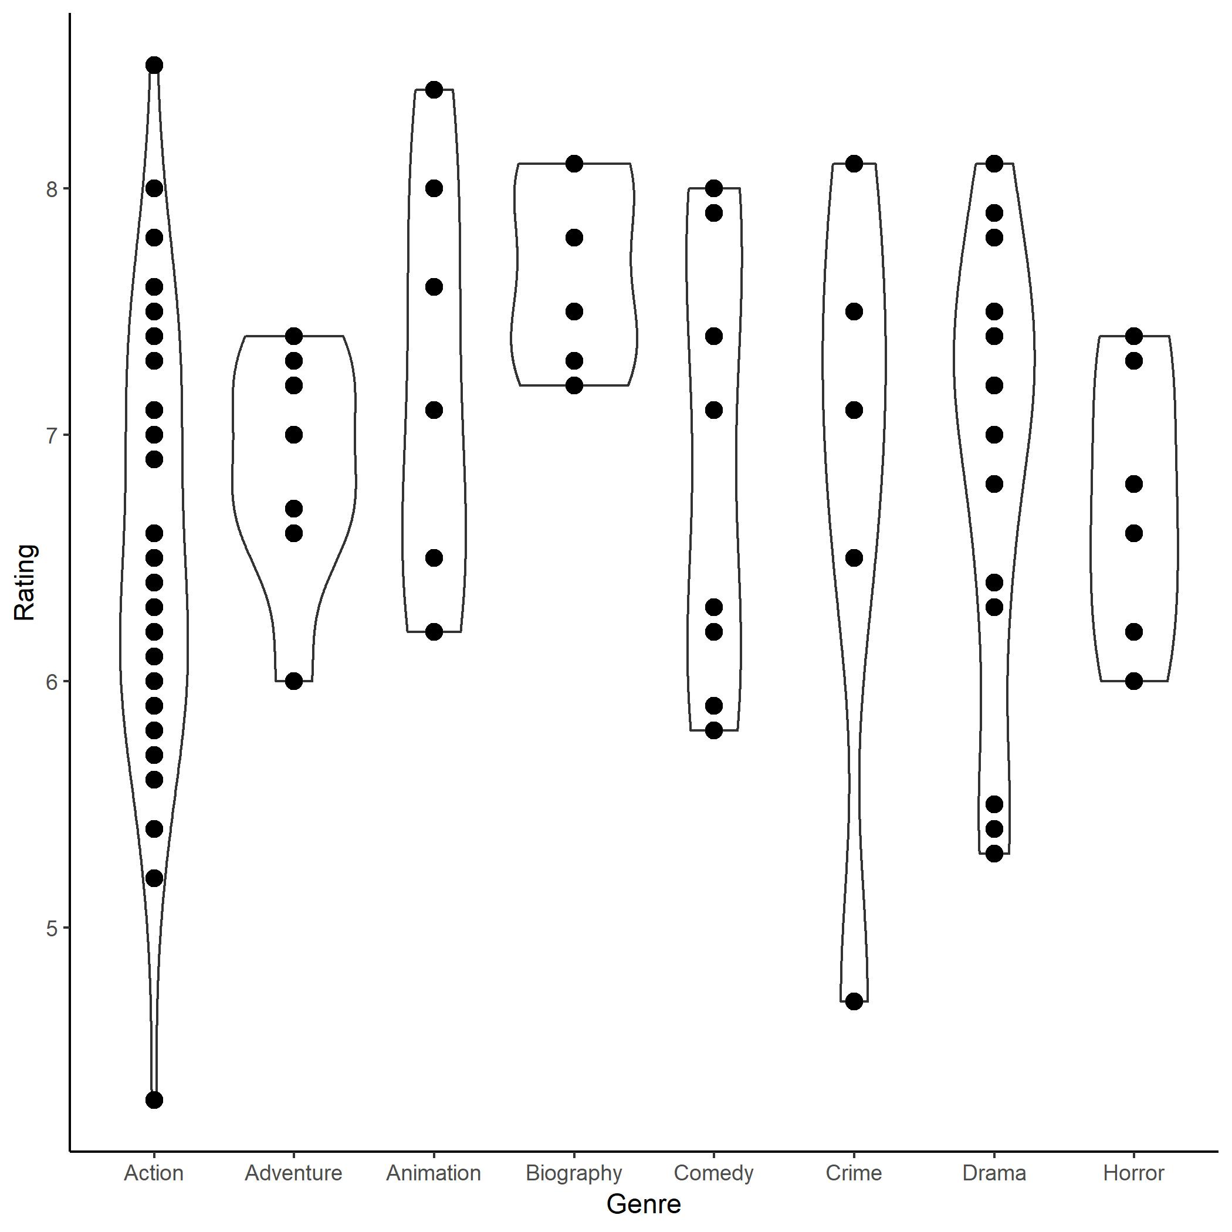
Statistical Graphs
Provide distribution and descriptive statistical information
Boxplots
Violin Graphs

Slide 34
Other Graphs
Stacked Plots
Polar Coordinate Graph
Facet Graph
Combined Charts
Heat Map
Geographic Map

Slide 35
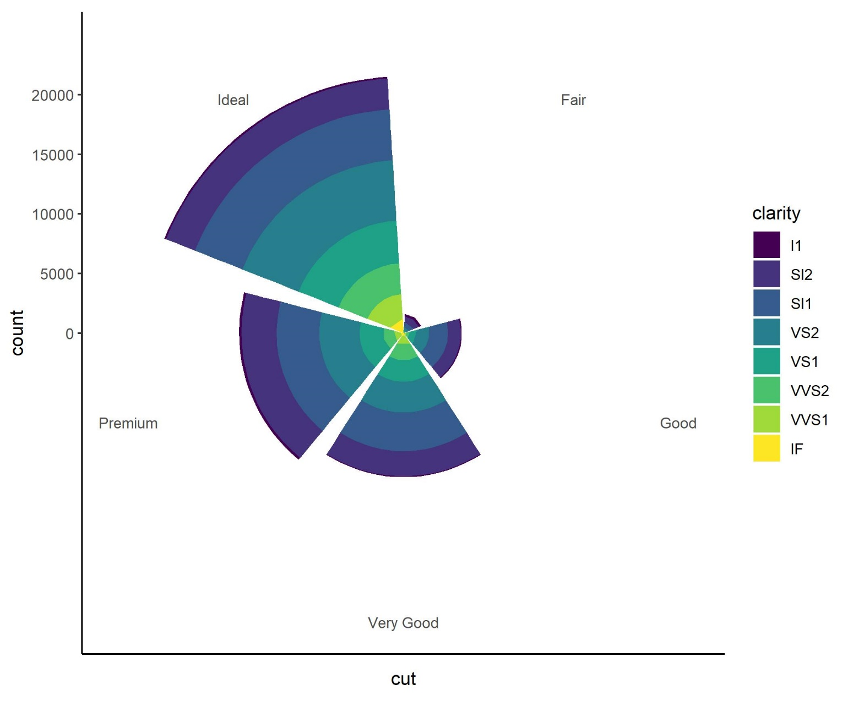
Other Graphs
Stacked Plots
Polar Coordinate Graph
Facet Graph
Combined Charts
Heat Map
Geographic Map

Slide 36
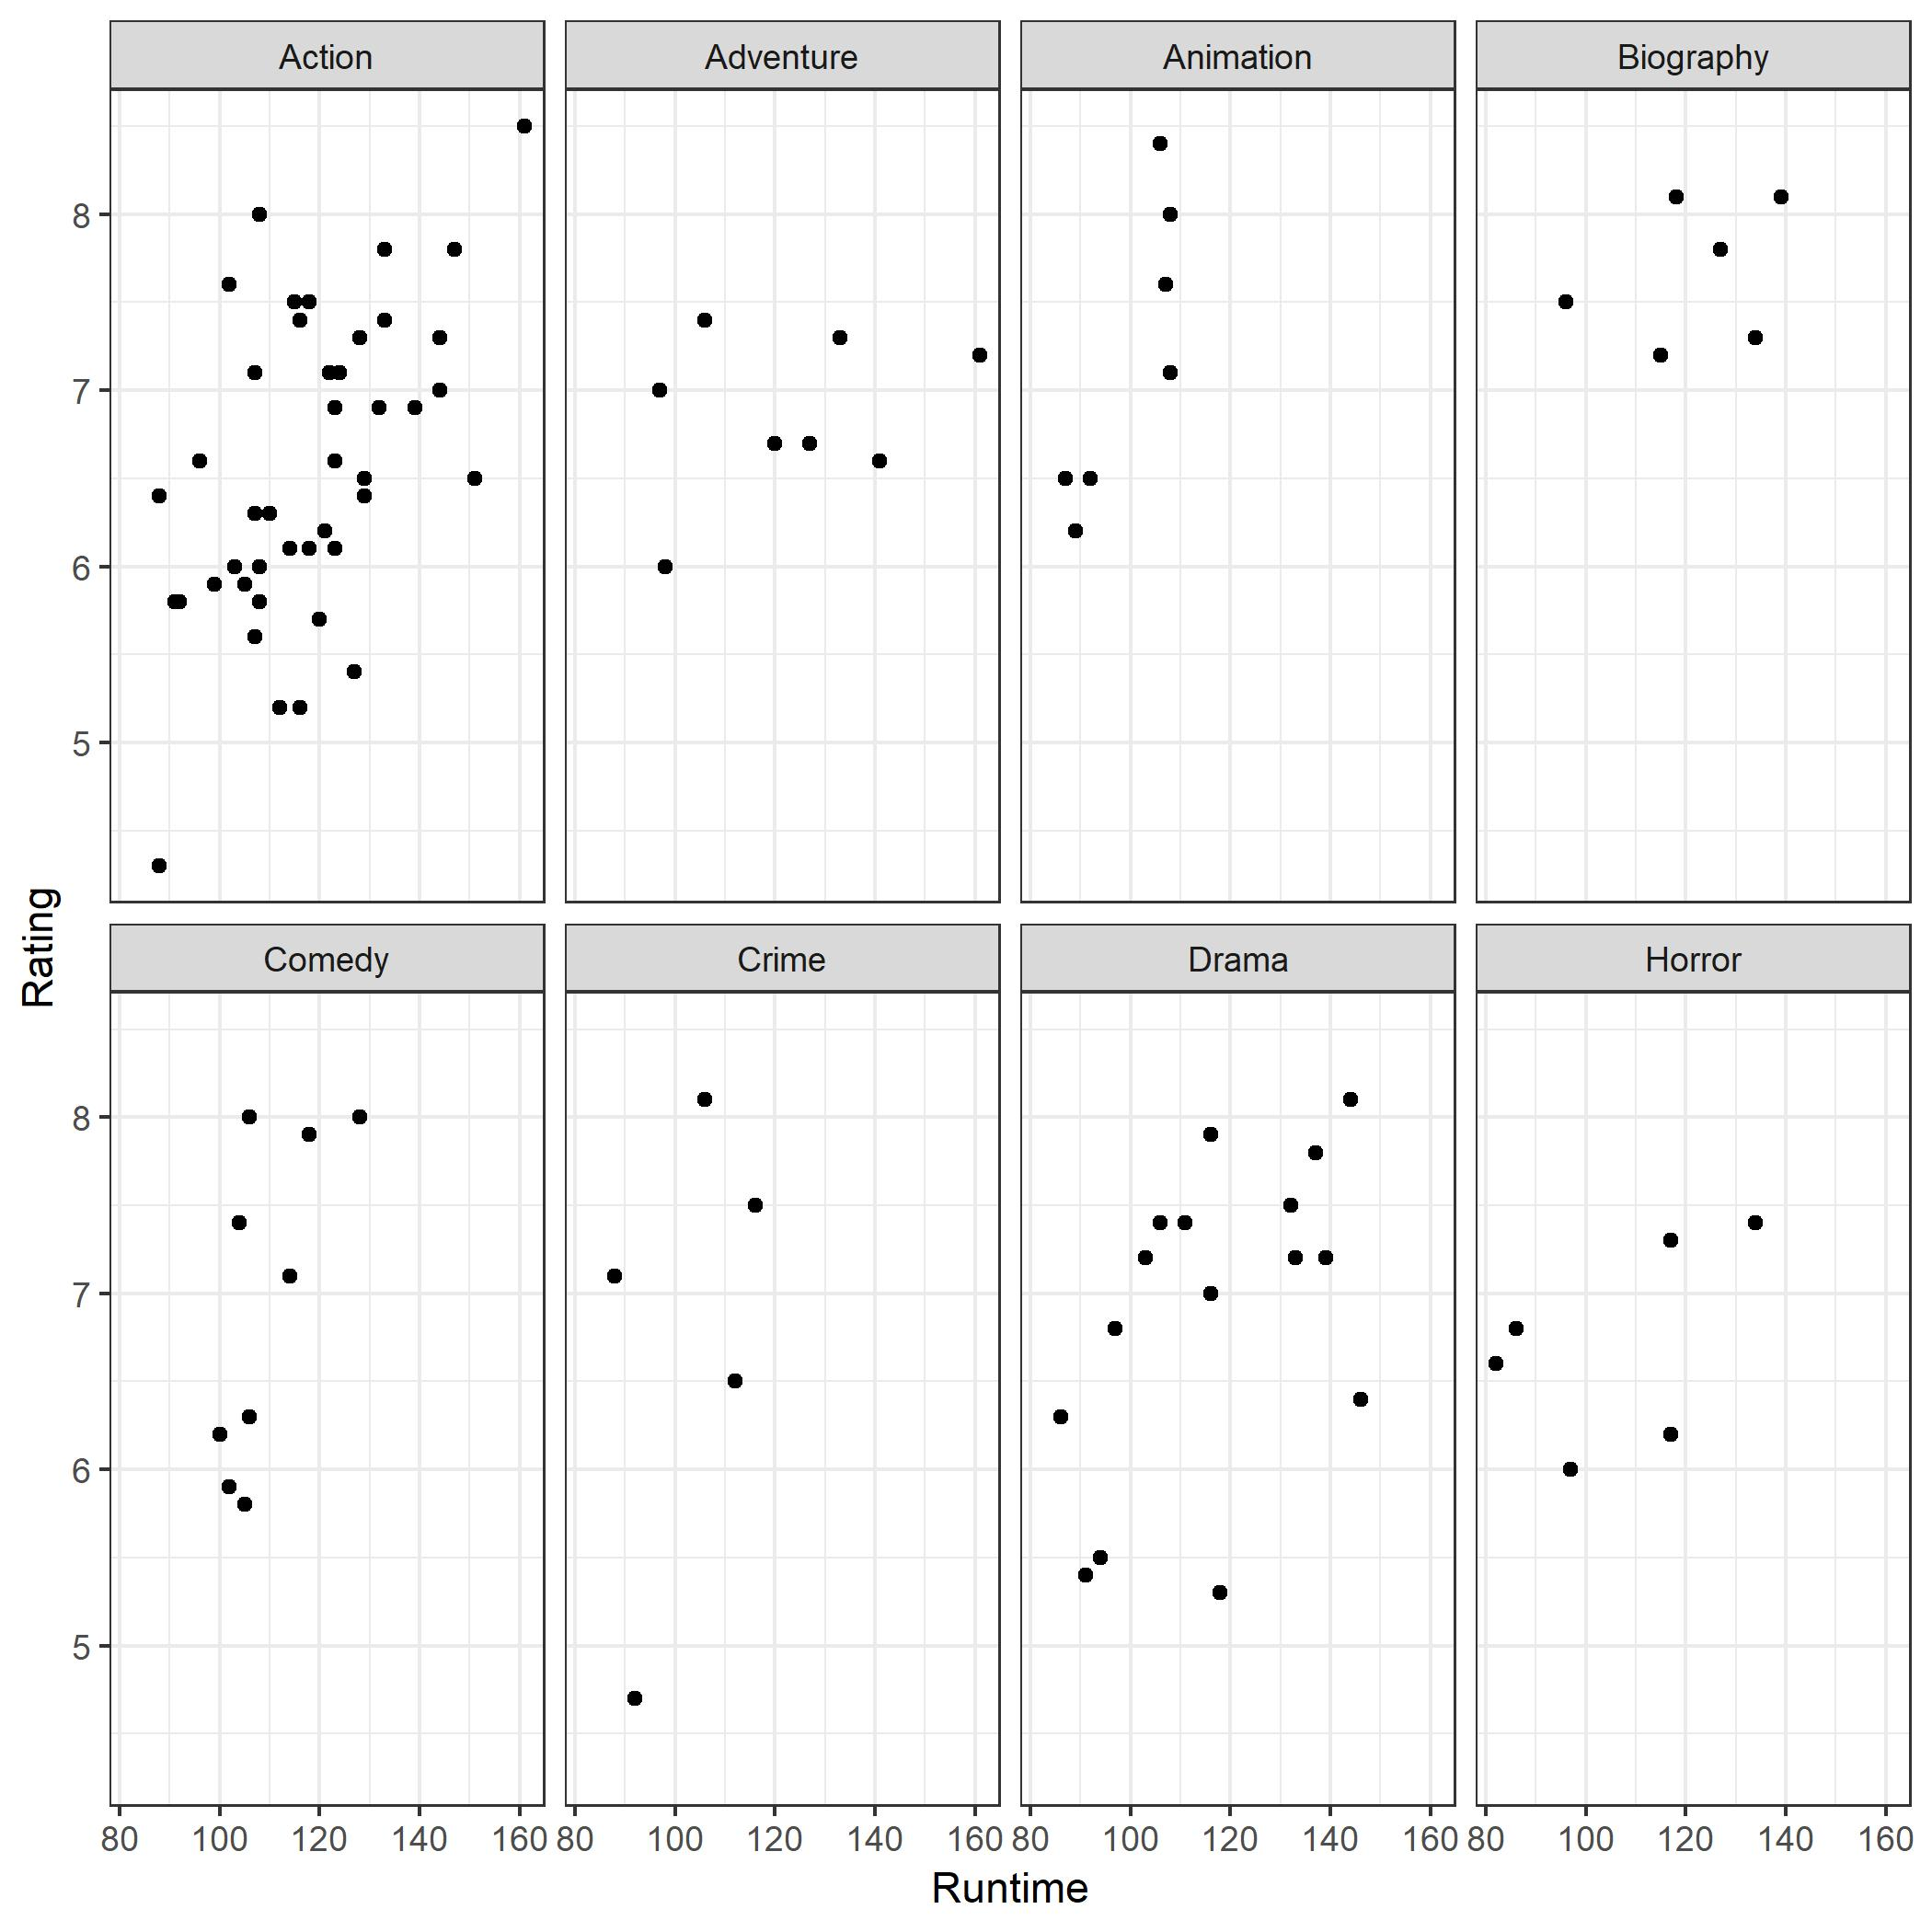
Other Graphs
Stacked Plots
Polar Coordinate Graph
Facet Graph
Combined Charts
Heat Map
Geographic Map

Slide 37
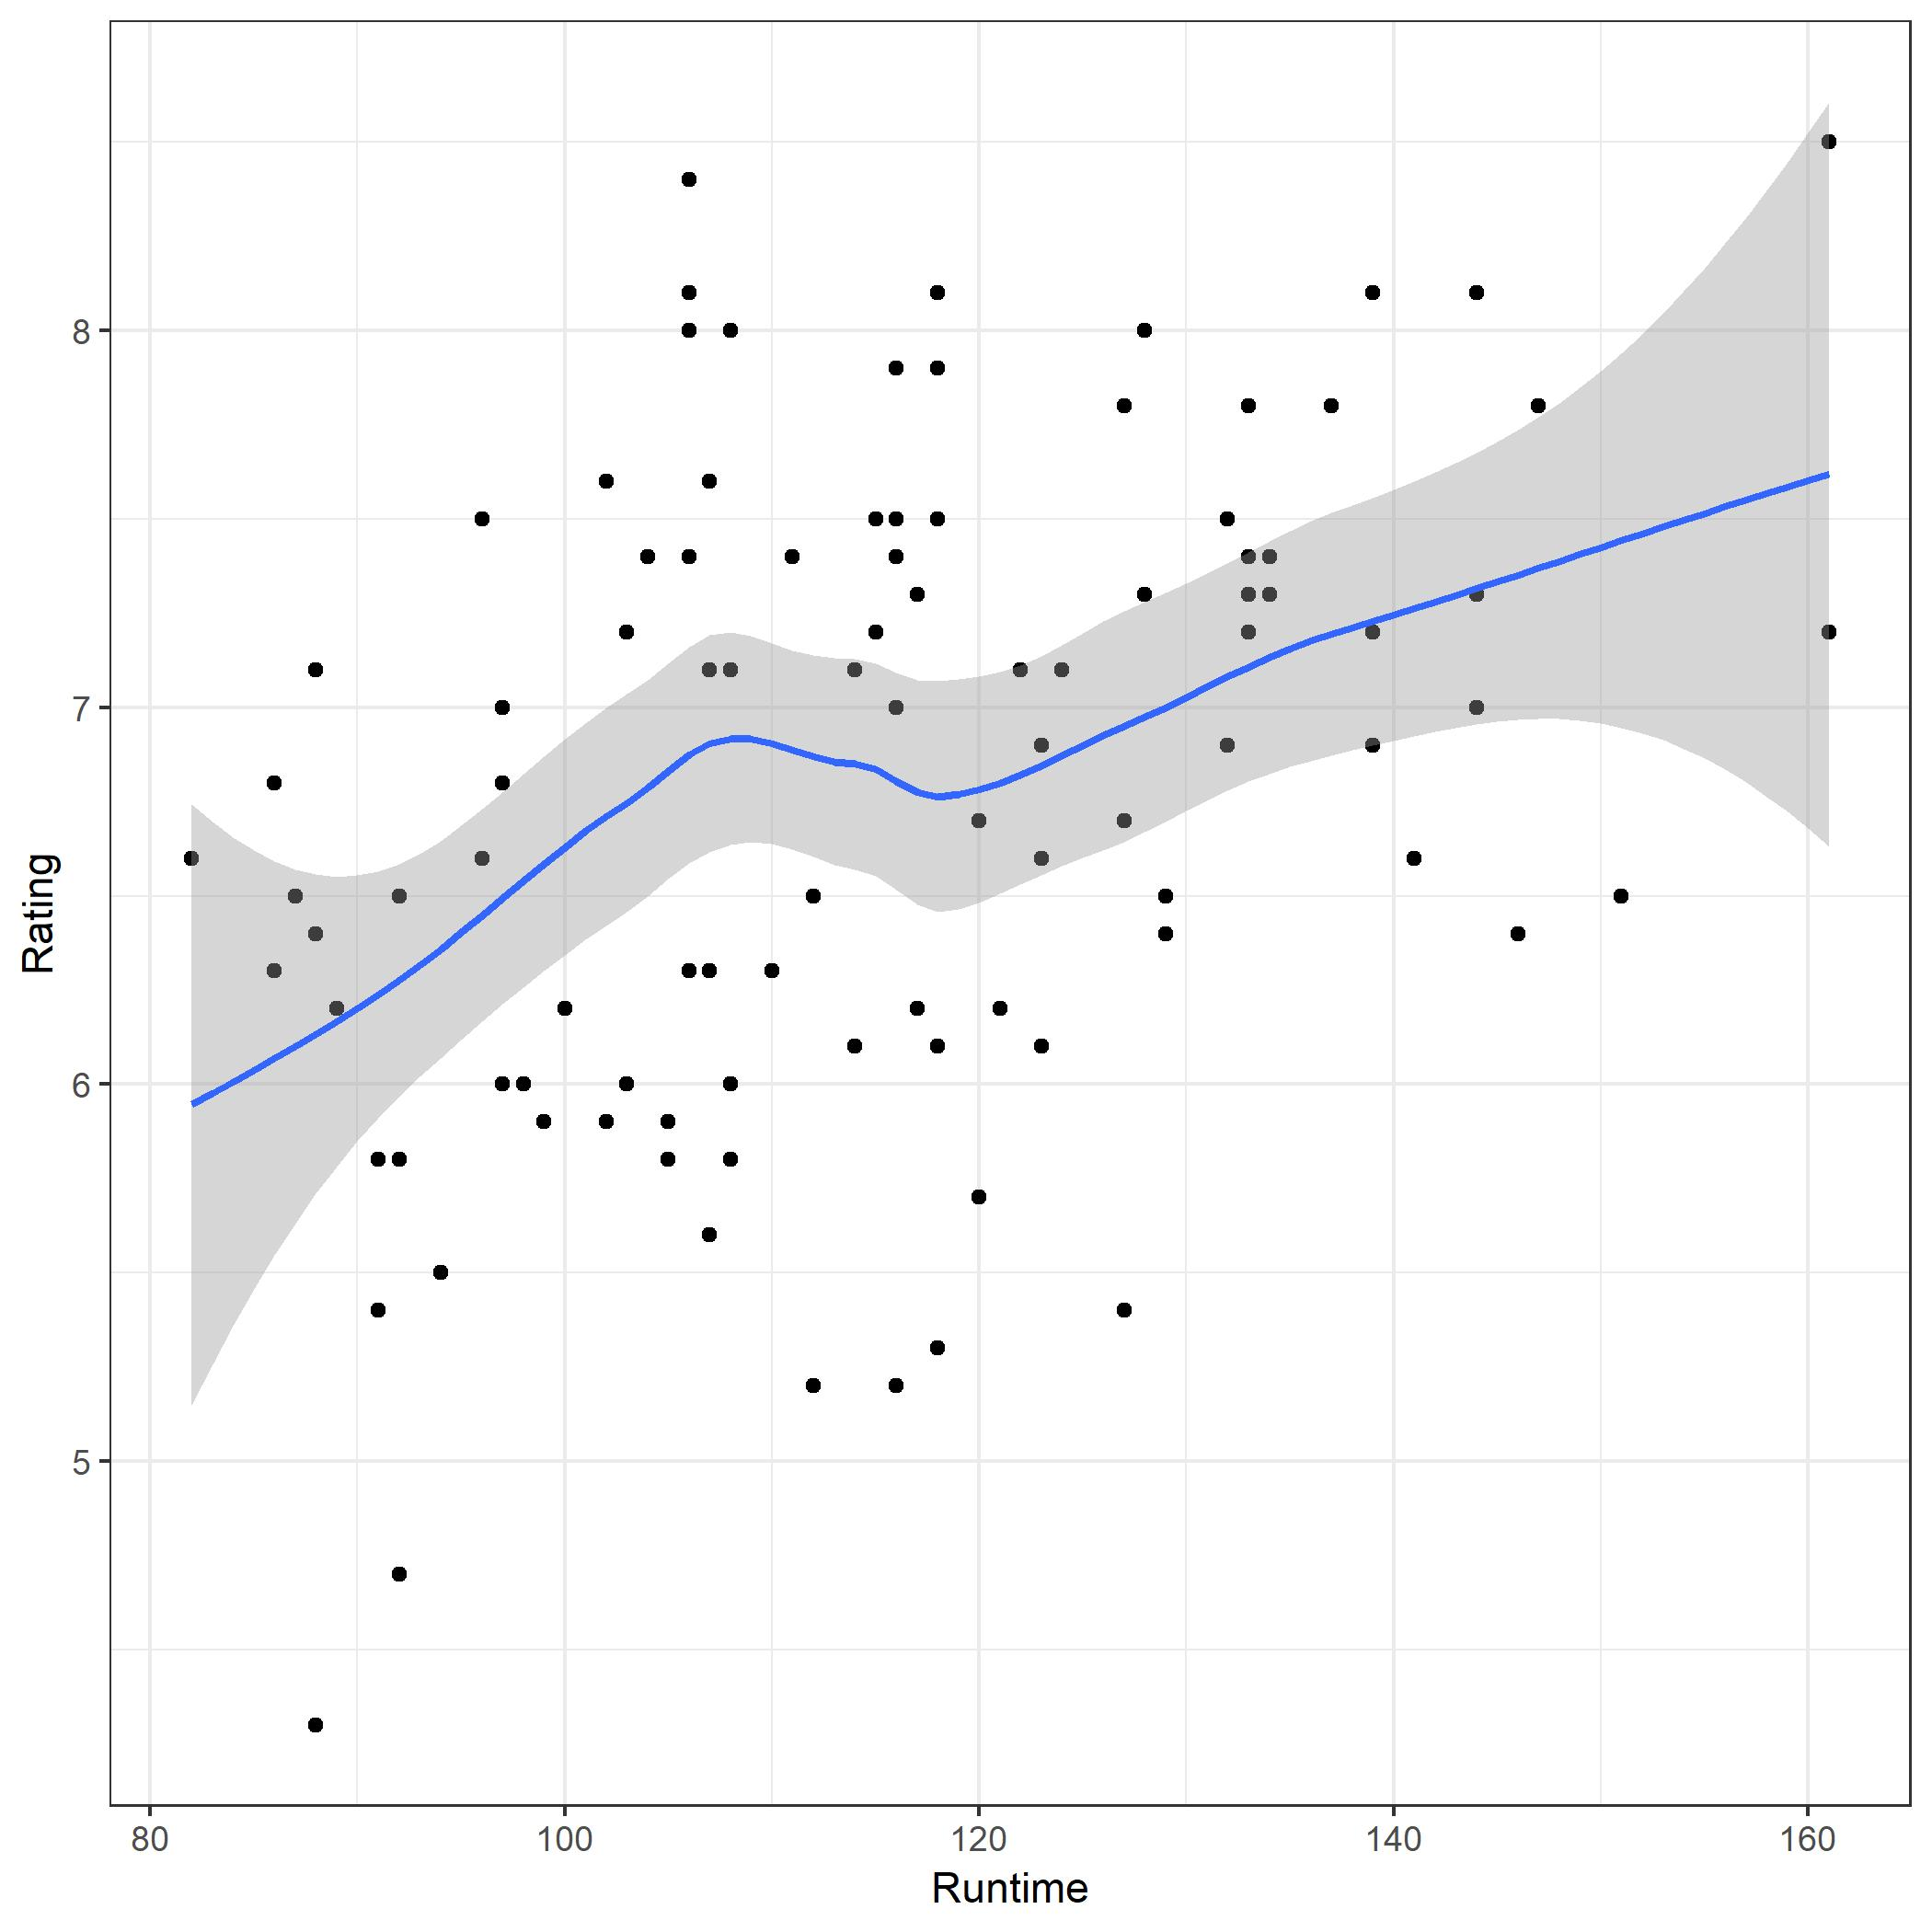
Other Graphs
What does the blue line tell you?
Stacked Plots
Polar Coordinate Graph
Facet Graph
Combined Charts
Heat Map
Geographic Map

Slide 38
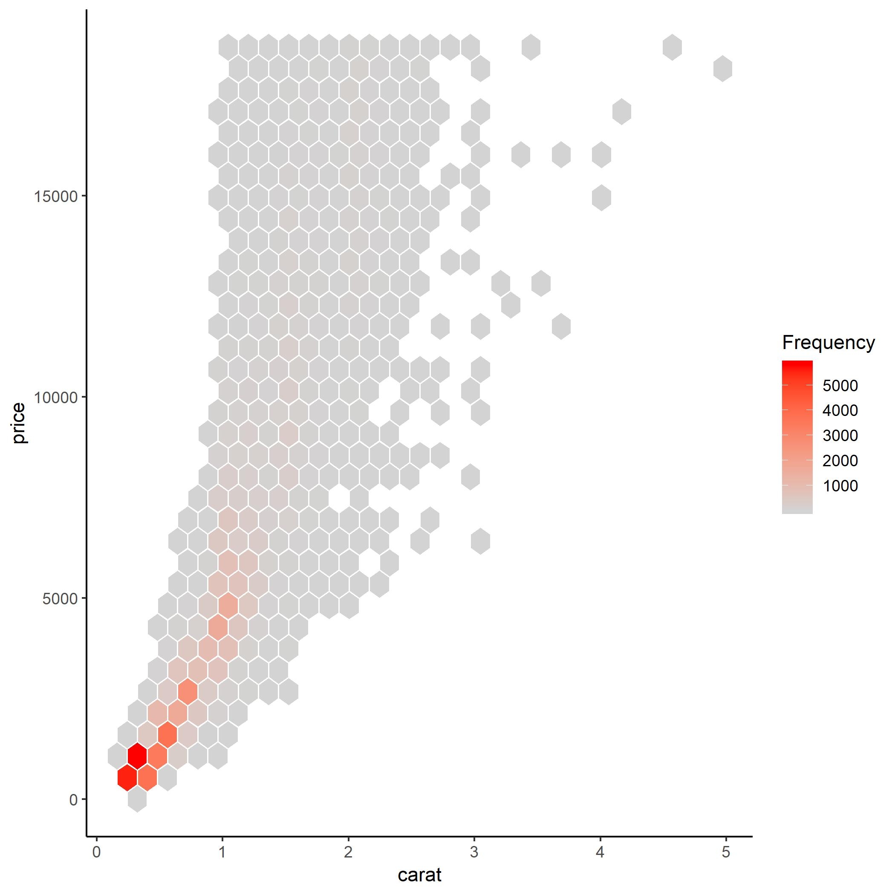
Other Graphs
Polar Coordinate Graph
Facet Graph
Combined Charts
Heat Map
Geographic Map

Slide 39
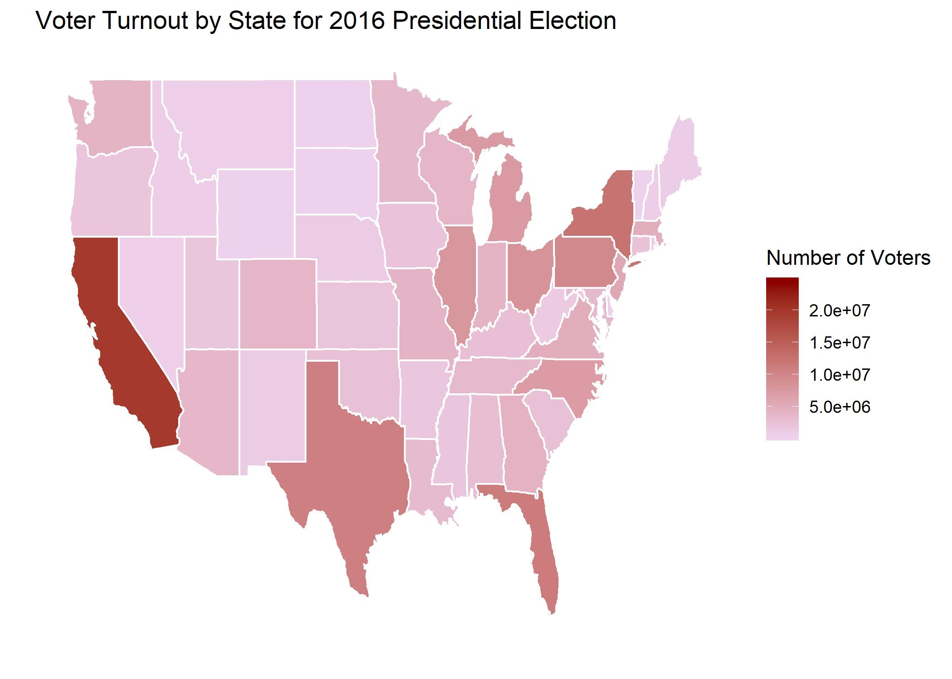
Other Graphs
Polar Coordinate Graph
Facet Graph
Combined Charts
Heat Map
Geographic Map

Slide 40
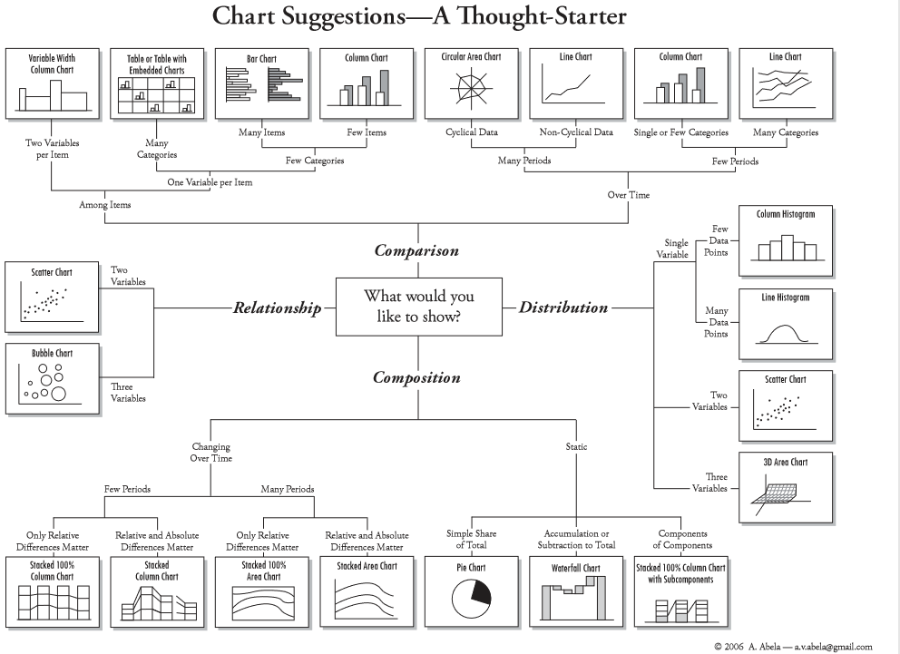

Slide 41
Workshop Agenda
Introduction to Data Visualization
Why We Visualize
Understanding Data
Visualizations
Tools and Software
Visualization Design and Best Practices

Slide 42















Data Visualization Software
Free:
Orange
QGIS
R
Python
Tableau (public)
Java-Script
D3
Leaflet
Chartist
Plotly
Cost:
Excel
Power BI (Microsoft
Tableau (Desktop)
SPSS
SAS
MATLAB
ArcGIS
Looker

Slide 43


The Right Tool for the Job
Things to consider:
What are your deliverables?
Bar chart, analytical model, dashboard?
Data size
Cost
Time
Reproducibility
Industry Standards
Etc.

Slide 44
Workshop Agenda
Introduction to Data Visualization
Why We Visualize
Understanding Data
Visualizations
Tools and Software
Visualization Design and Best Practices

Slide 45
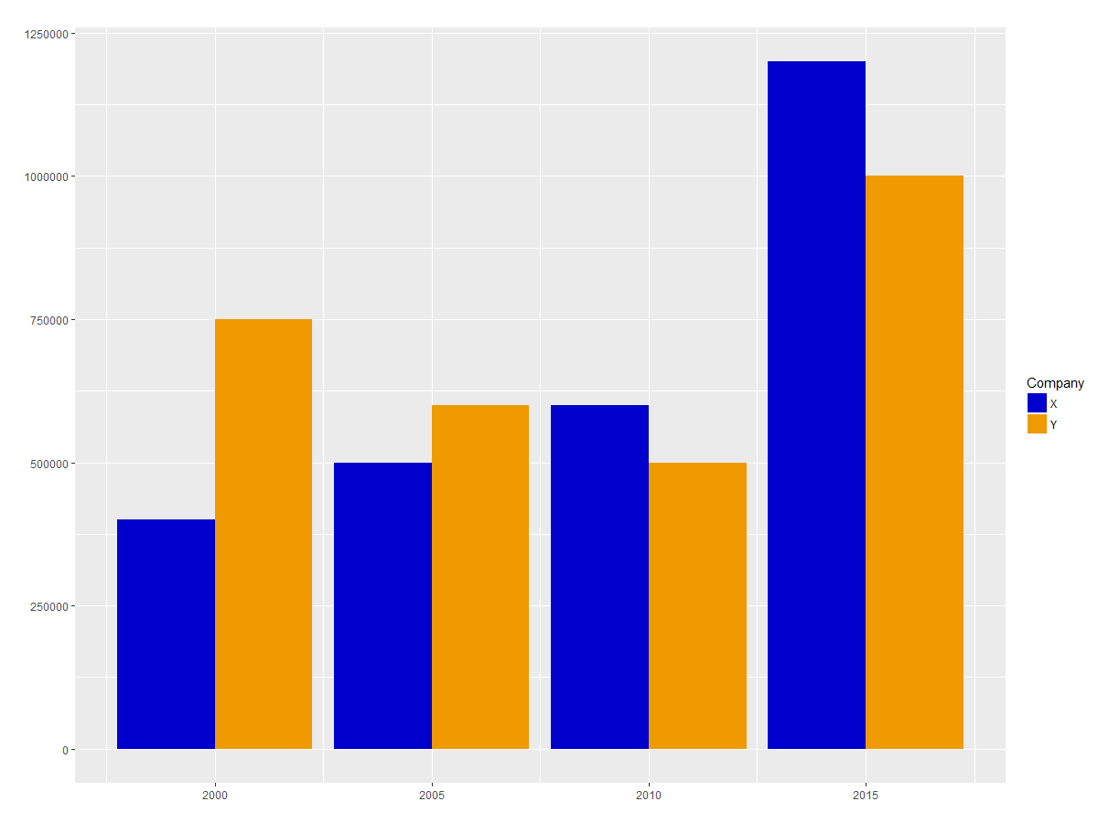
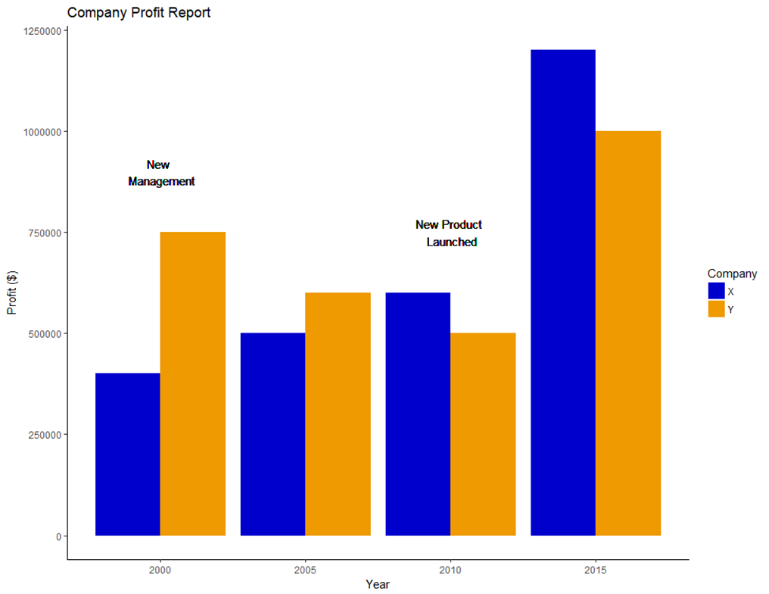
Best Practices
Layout Design
Title
Axes
Annotations
Themes
Colors
Use fewer than 6 colors
Use color opposites
Don’t Fight Established Norms
Scales, Distortion, Chart Types

Slide 46
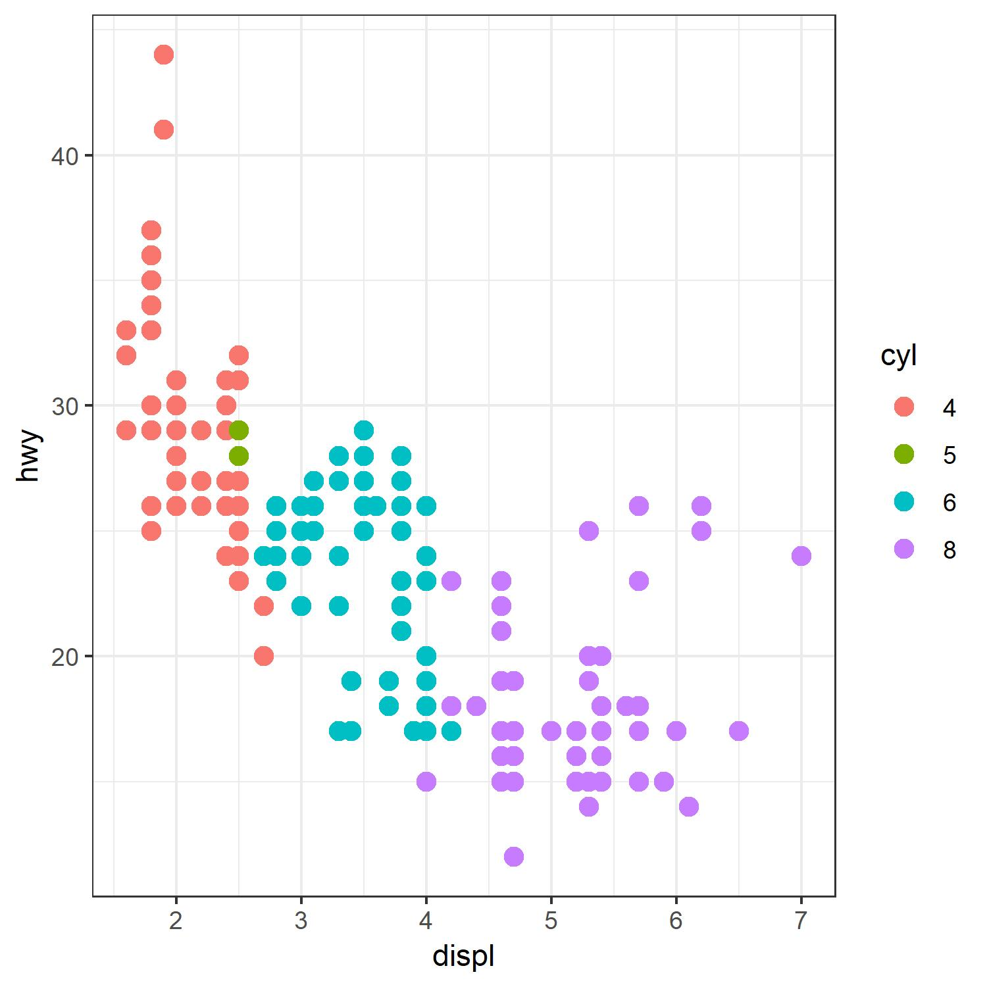
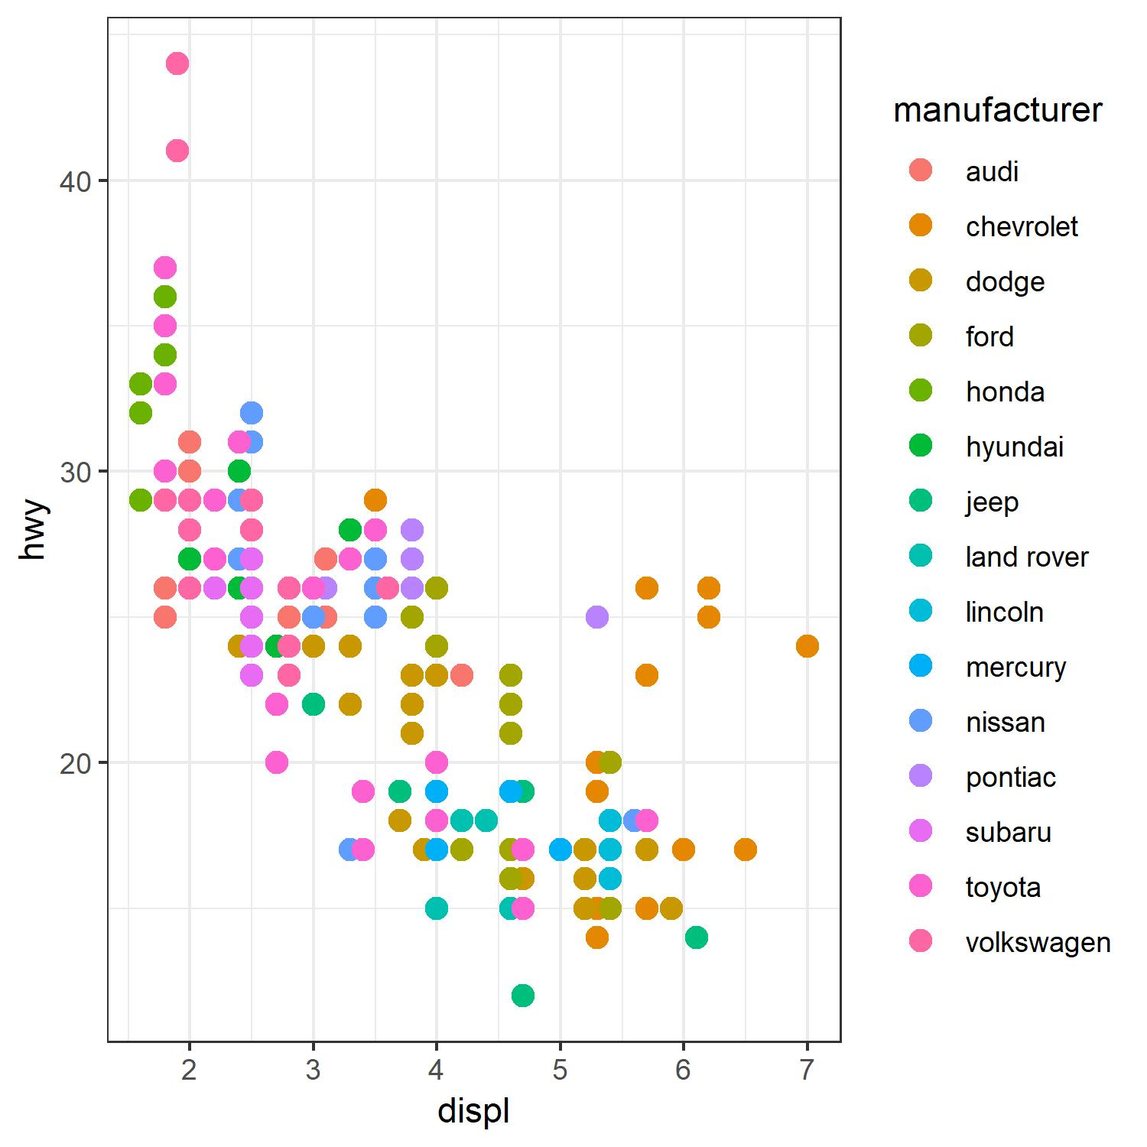
Best Practices
Layout Design
Title
Axes
Annotations
Themes
Colors
Use fewer than 6 colors
Use color opposites
Don’t Fight Established Norms
Scales, Distortion, Chart Types

Slide 47
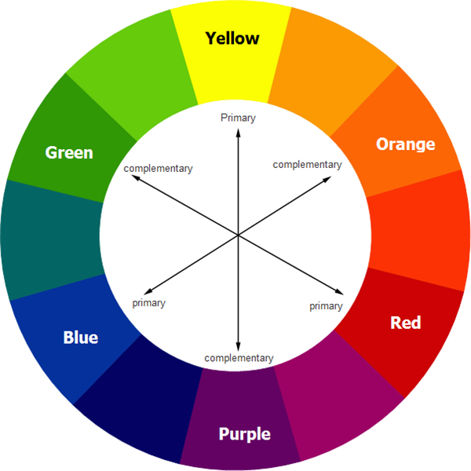
Best Practices
Layout Design
Title
Axes
Annotations
Themes
Colors
Use fewer than 6 colors
Use color opposites
Don’t Fight Established Norms
Scales, Distortion, Chart Types
www.edrawsoft.com/templates/pdf/color-wheel.pdf

Slide 48
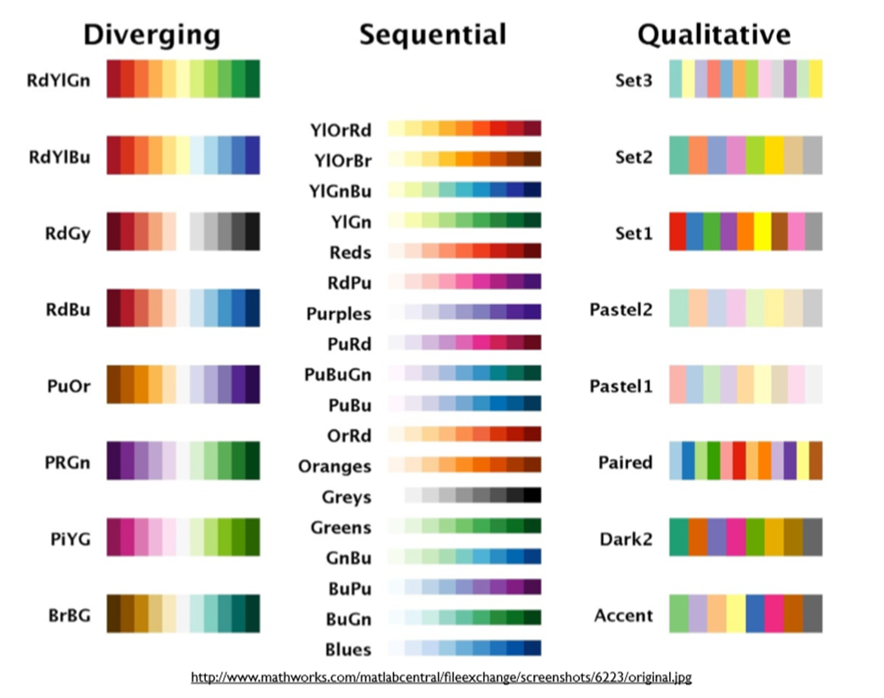
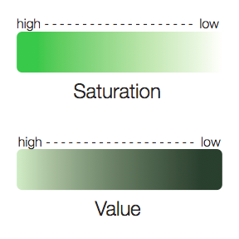
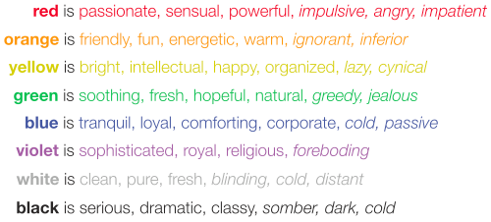
Best Practices
Layout Design
Title
Axes
Annotations
Themes
Colors
Use fewer than 6 colors
Use color opposites
Don’t Fight Established Norms
Scales, Distortion, Chart Types
https://socialh.com/choosing-colors-for-your-business-or-website/

Slide 49
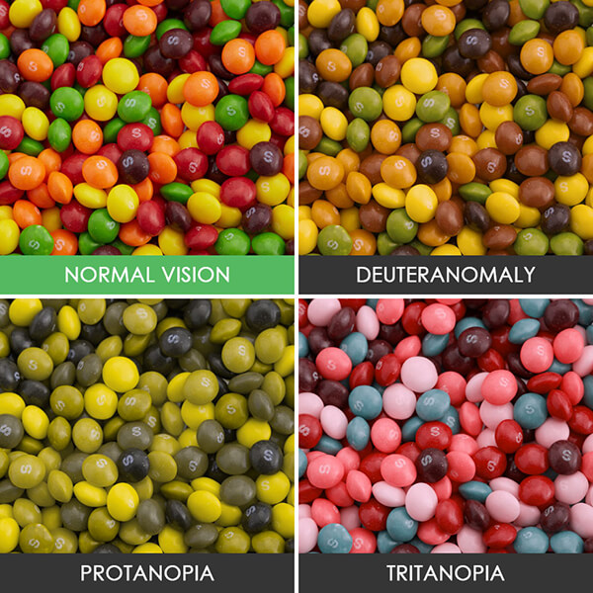
ADA Compliance
Red-Green
Deuteranomaly
Yellow and green appear redder
Difficult to tell violet from blue.
Most common affecting ~5% of males
Protanopia
Red appears as black.
Certain shades of orange, yellow, and green all appear as yellow.
Affects ~1% of males.
Blue-Yellow
Tritanopia
Blue appears green
Yellow appears violet or light grey
Extremely rare affecting males and females equally.

Slide 50
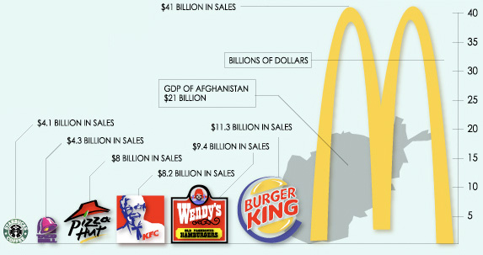
Best Practices
Layout Design
Title
Axes
Annotations
Themes
Colors
Use fewer than 6 colors
Use color opposites
Don’t Fight Established Norms
Scales, Distortion, Chart Types
https://eagereyes.org/blog/2008/linear-vs-quadratic-change

Slide 51
Chart Improvement Steps
1. Start with your message
Chart title should be main message and add subtitle for further clarification
2. Highlight only the important data
Pick 1-3 things to highlight or pick a different chart
3. Pick good colors
Use color sparingly/to highlight
Related things have related colors
Avoid bad pairings red and green (colorblind)
4. Use Logical Order: Others don’t care about original order
5. Eliminate junk: Delete legends, Remove axis lines, Remove or trim axis numbers
6. Add strategic labels
Legend: Put series name right next to the data on the plot
Axis numbers: Label data directly
Data from: Briney, K., Goben, A., & Zilinski, L. (2015). Do You Have an Institutional Data Policy? A Review of the Current Landscape of Library Data Services and Institutional Data Policies. Journal of Librarianship and Scholarly Communication, 3(2), eP1232. DOI: http://doi.org/10.7710/2162-3309.1232

Slide 52
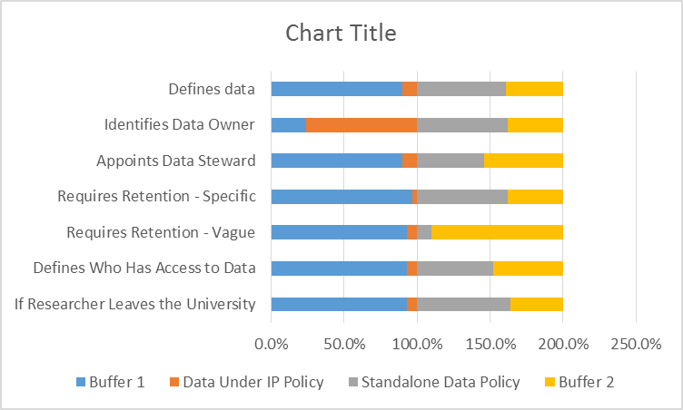
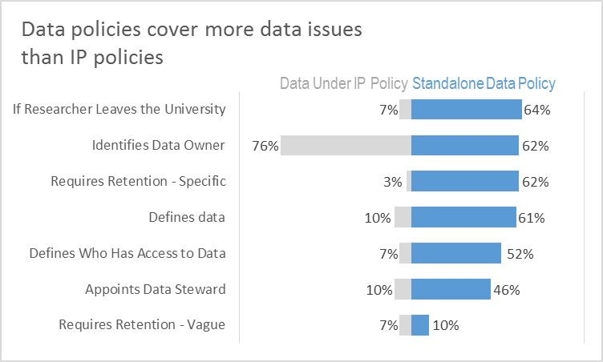
Before and After
Data from: Briney, K., Goben, A., & Zilinski, L. (2015). Do You Have an Institutional Data Policy? A Review of the Current Landscape of Library Data Services and Institutional Data Policies. Journal of Librarianship and Scholarly Communication, 3(2), eP1232. DOI: http://doi.org/10.7710/2162-3309.1232

Slide 53
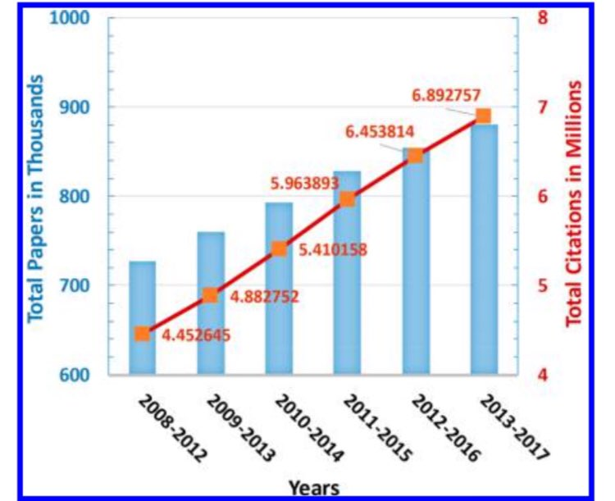
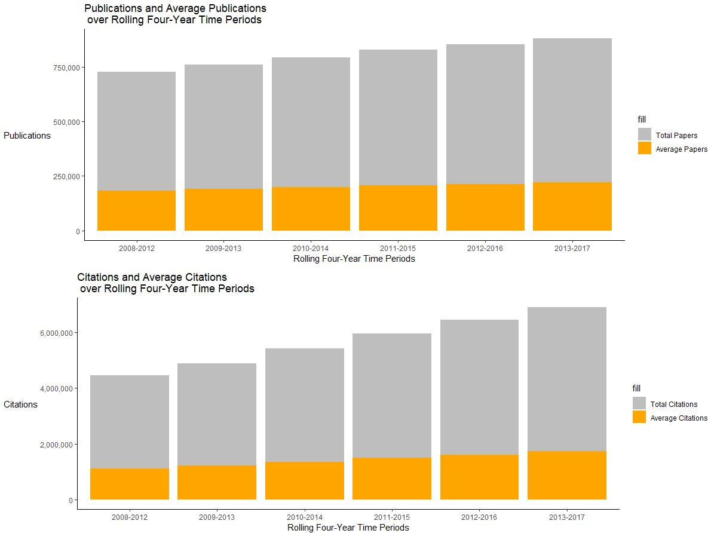
Before and After

Slide 54
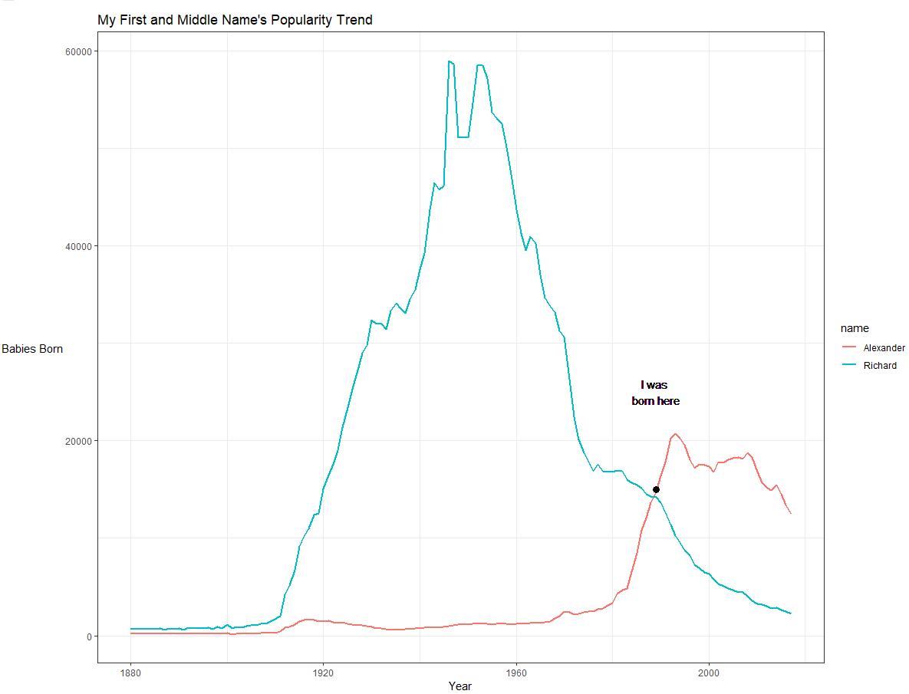
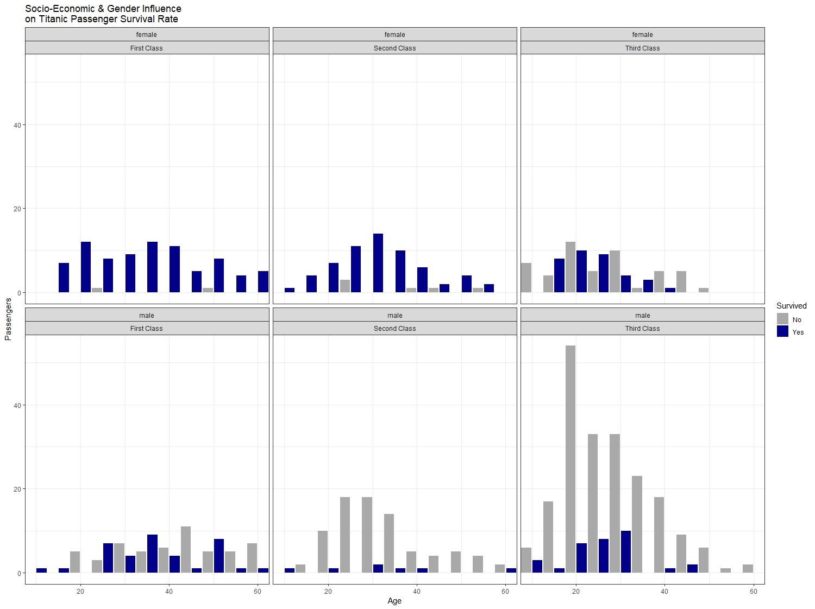
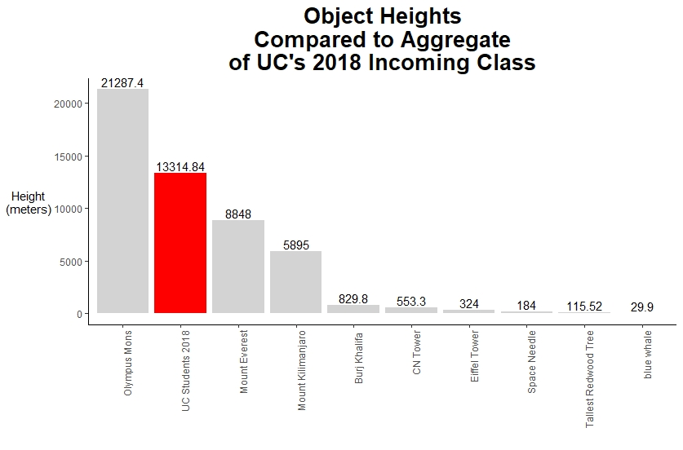
Examples

Slide 55
Want to continue learning Data Visualization?
Academic Courses:
BANA 5137/6037– Data Visualization
GEOG 5198C/6098C - Practical Data Mining and Visualization
PLAN 5172 – Intro to Planning & Design Visualization
CODE 3041 - Core Topics in Graphic Design
Lynda:
Learning Data Visualization
Data Visualization for Data Analysts
Designing a Data Visualizations
Dozens more...
Library Workshops:
https://webapps2.uc.edu/ce/facdev/Workshops

Slide 56
Additional Online Resources
General Viz Help:
http://datavizproject.com/
http://flowingdata.com
http://www.dailyinfographic.com
http://www.informationisbeautiful.net
https://datavizcatalogue.com/
http://www.datacarpentry.org/
https://data-to-viz.com
Visualization in R
Grammar of Graphics (Hadley Wickham)
https://www.analyticsvidhya.com/blog/2015/07/guide-data-visualization-r/
Tableau
https://public.tableau.com/en-us/s/gallery
http://www.vizwiz.com/
D3.js
https://github.com/d3/d3/wiki/gallery
http://mbostock.github.io/d3/talk/20111116/bundle.html
http://animateddata.co.uk/lab/d3-tree/

Slide 57
Contact Research & Data Services
Email: AskData@uc.edu
Web: https://libraries.uc.edu/digital-scholarship/data-services.html
Visit: 240 Braunstein Hall (Geology-Math-Physics Library)
Consultations: walk-ins during open consultation hours or appointment by email
Twitter: @Johansen_PhD
GitHub:https://github.com/RAJohansen/UCL_Workshops

